Slide 1
Informatica PowerCenter 8.6
Basics Training Course

Slide 2
Introduction
At the end of this course you will -
Understand how to use all major PowerCenter 8.6 components
Be able to perform basic administration tasks
Be able to build basic ETL Mappings and Mapplets
Understand the different Transformations and their basic attributes in PowerCenter 8.6
Be able to create, run and monitor Workflows
Understand available options for loading target data
Be able to troubleshoot common development problems

Slide 3
ETL Basics

Slide 4
This section will include -
Concepts of ETL
PowerCenter 8.6 Architecture
Connectivity between PowerCenter 8.6 components

Slide 5



Extract, Transform, and Load
Operational Systems
Decision Support
Other
Data Warehouse
RDBMS
Mainframe
Transaction level data
Cleanse Data
Apply Business Rules
Aggregate Data
Consolidate Data
De-normalize
Aggregated data
Optimized for Transaction Response Time
Historical
Current
Normalized or De- Normalized data
Transform
ETL
Extract
Load
Notes:
The Explanation of The ETL process. ETL process is central to the whole Data Warehousing Solution.
Informatica approach to ETL relates some Key terms to the process. Understanding of these terms in the initial stage itself is vital to understanding the Informatica Tool and feeling more comfortable with it.
Informatica relates the Extraction process through ‘Source Definitions’. Wherein the source definitions (Data Structure in source) is imported and analyzed based on the required Business Logic.
The Transformation process on a basic level is related through the use of ‘Transformations’ in Informatica PowerCenter. Transformations are the built in functions provided by Informatica which can be customized as per the Business Logic. The data extracted as per the analyzed ‘Source Definitions’ is transformed here.
The Load Process is related through the use of ‘Target Definitions’. The target definitions are defined as per the design of the Warehouse and loaded with the transformed Data.
This whole information of the Source Definitions, Transformations, Target Definitions and the related Work Flow is contained in a mapping. Thus a ‘Mapping’ relates to the ETL process definition.

Slide 6
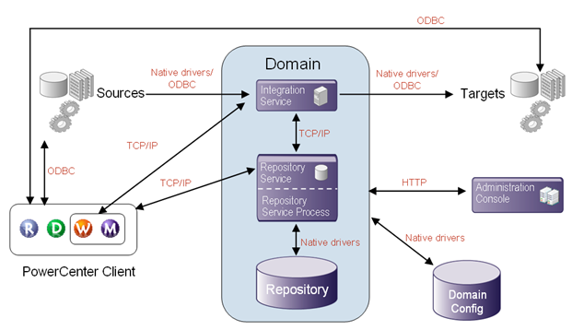
PowerCenter 8.6 Architecture
Notes:
Domain – Logical ETL environment. Could be for a Business Unit or could be enterprise wide
Node – Physical machines on which PowerCenter services are installed
Application Services – ETL and metadata services
Core Services – House keeping the ETL environment

Slide 7
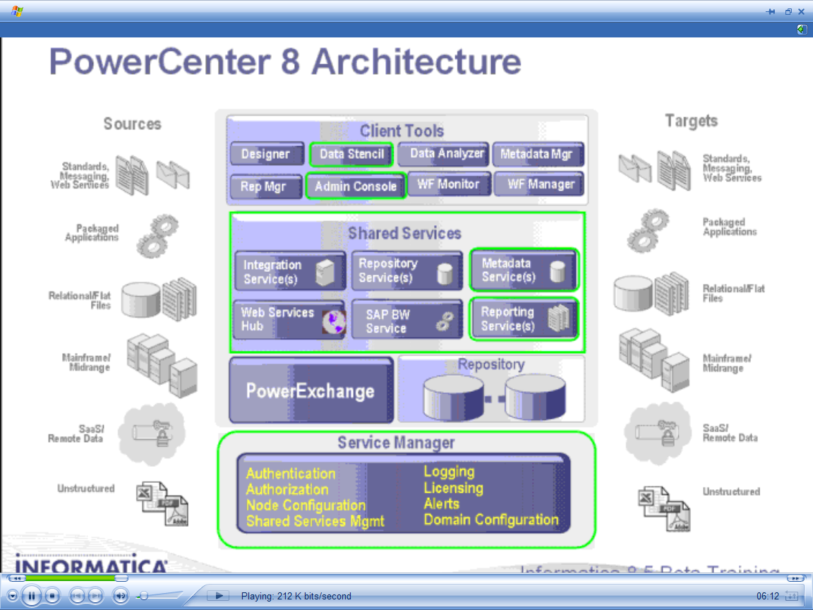
PowerCenter 8.6 Components

Slide 8
PowerCenter 8.6 Components
PowerCenter Repository
Repository Service
Integration Service
Core Services
PowerCenter Client
Administration Console
Repository Manager
Designer
Workflow Manager
Workflow Monitor
External Components
Sources
Targets
Application Services
Notes:
Thus, through this discussion we arrive at the above components in Informatica PowerCenter.
Server Components – Domain and Nodes that run Core services and Application services
Client Components – Administration Console, Designer, Repository Manager, Workflow Manager, Workflow Monitor. These Clients interacts with the server components and the External components for performing their intended functions.
External Components – Sources and Targets.

Slide 9
Introduction To PowerCenter Repository and Administration

Slide 10
This section includes -
The purpose of the Repository and Repository Service
The Administration Console
The Repository Manager
Administration Console maintenance operations
Security and privileges
Object sharing, searching and locking
Metadata Extensions
Version Control

Slide 11
PowerCenter Repository
It is a relational database managed by the Repository Service
Stores metadata about the objects (mappings, transformations etc.) in database tables called as Repository Content
The Repository database can be in Oracle, IBM DB2 UDB, MS SQL Server or Sybase ASE
To create a repository service one must have full privileges in the Administrator Console and also in the domain
Integration Service uses repository objects for performing the ETL
Notes:
It is the metadata hub of PowerCenter suite. Any activity happening via client tools or within a domain is written to the repository tables.
Integration service accesses repository metadata for authenticating PowerCenter users, connecting to sources and targets and executing ETL tasks.

Slide 12
Repository Service
A Repository Service process is a multi-threaded process that fetches, inserts and updates metadata in the repository
Manages connections to the Repository from client applications and Integration Service
Maintains object consistency by controlling object locking
Each Repository Service manages a single repository database. However multiple repositories can be connected and managed using repository domain
It can run on multiple machines or nodes in the domain. Each instance is called a Repository Service process
Notes:
Serializes connections to the Repository. Only service that enables access of Repository metadata.

Slide 13
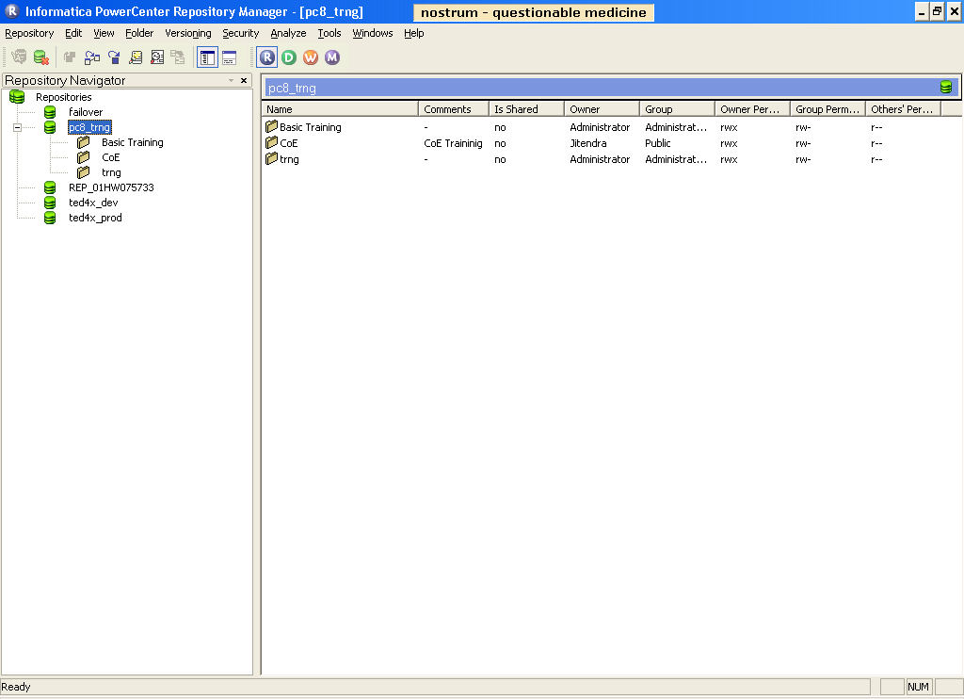

Repository Connections
Each Repository has a repository service assigned for the management of the physical Repository tables
1
PowerCenter Client
Node A
Node A
Node B (Gateway)
Service Manager
Service Manager
Application Service
Repository Service
3
Application Service
TCP/IP
2
Repository Database
4
Repository
Manager
Administration Console
Native Connectivity or ODBC Driver

Slide 14
PowerCenter Administration Console
A web-based interface used to administer the PowerCenter domain.
Following tasks can be performed:
Manage the domain
Shutdown and restart domain and Nodes
Manage objects within a domain
Create and Manage Folders, Grid, Integration Service, Node, Repository Service, Web Service and Licenses
Enable/ Disable various services like the Integration Services, Repository Services etc.
Upgrade Repositories and Integration Services
View log events for the domain and the services
View locks
Add and Manage Users and their profile
Monitor User Activity
Manage Application Services
Default URL <> http://<hostname>:6001/adminconsole
Notes:
Web-based interface for managing Informatica environment.

Slide 15
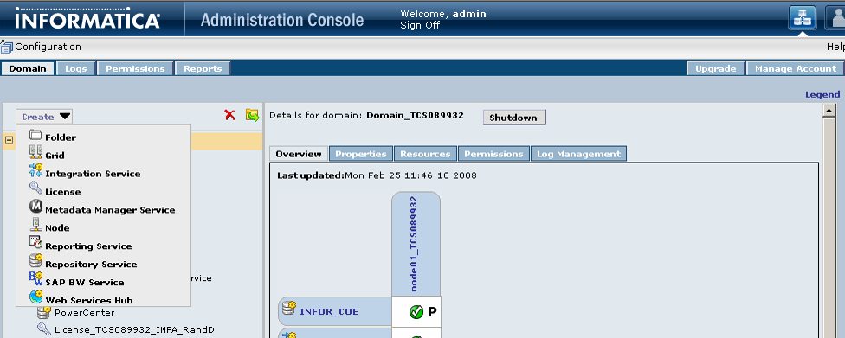
PowerCenter Administration Console
For Creating Folder, Grid, Integration Service, Repository Service
Navigation Window
Other Important Task Include
Managing Objects like services, nodes, grids, licenses etc. and security within a domain
Managing Logs
Create &Manage Users
Upgrading Repository & Server
Shutdown Domain
Main Window
**Upgrading Repository means updating configuration file and also the repository tables

Slide 16
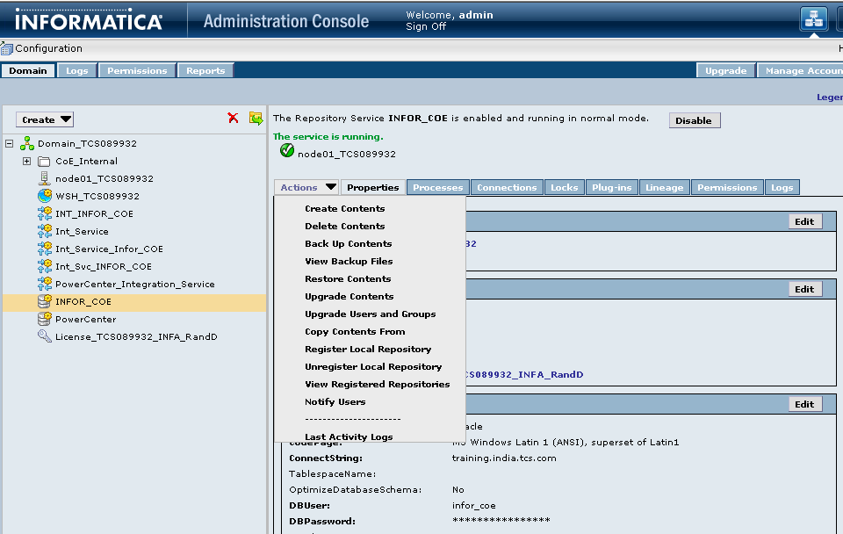
Repository Management
Perform all Repository maintenance tasks through Administration Console
Create/Modify the Repository Configuration
Select Repository Configuration and perform maintenance tasks:
Manage Connections
Notify Users
Propagate
Register/Un-Register Local Repositories
Edit Database properties
Create Contents
Delete Contents
Backup Contents
Copy Contents from
Upgrade Contents
Disable Repository Service
View Locks

Slide 17
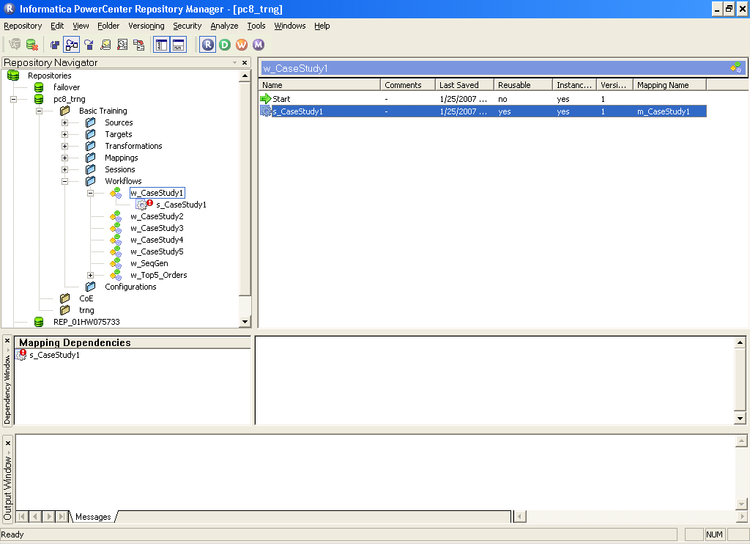
Repository Manager Interface
Navigator Window
Main Window
Shortcut Dependencies
Dependency Window
Output Window

Slide 18
Repository Manager
Use Repository manager to navigate through multiple folders and repositories.
Perform following tasks:
Add/Edit Repository Connections
Search for Repository Objects or Keywords
Implement Repository Security(By changing the password only)
Perform folder functions ( Create , Edit , Delete ,Compare)
Compare Repository Objects
Manage Workflow/Session Log Entries
View Dependencies
Exchange Metadata with other BI tools
Notes:
All the information about the users, groups and privileges is also stored in the repository. The repository manager is used to create, delete and modify Users, Groups and their associated privileges.
All users work in their own folders. All their objects are directly reflected and maintained in their own folder. A folder is thus a logical organization of the repository objects according to the User.
Repository contains information about number of objects. Its thus Data about data called Metadata. This Metadata is very vital to understanding the whole ETL related project environment. This metadata can be analyzed to determine the information related to sources, transformations, mapping, number of users or even the loading sessions among many other information. The ‘Repository Manager’ can be used to view some of this related Metadata as Sources, Target , Mappings and Dependencies.
Shortcut dependencies refer to the dependency between mappings or objects wherein object has a shortcut to other objects. Shortcuts refers to a link which points to object in other’s folder. That way we don’t need to again create or copy the object and may reuse it using a shortcut.

Slide 19
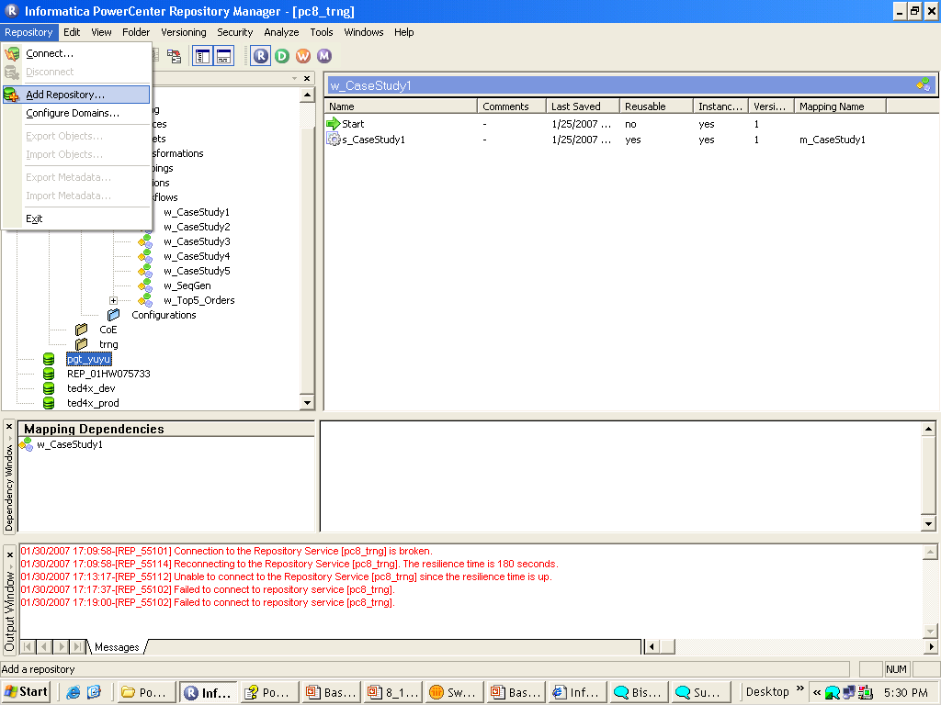
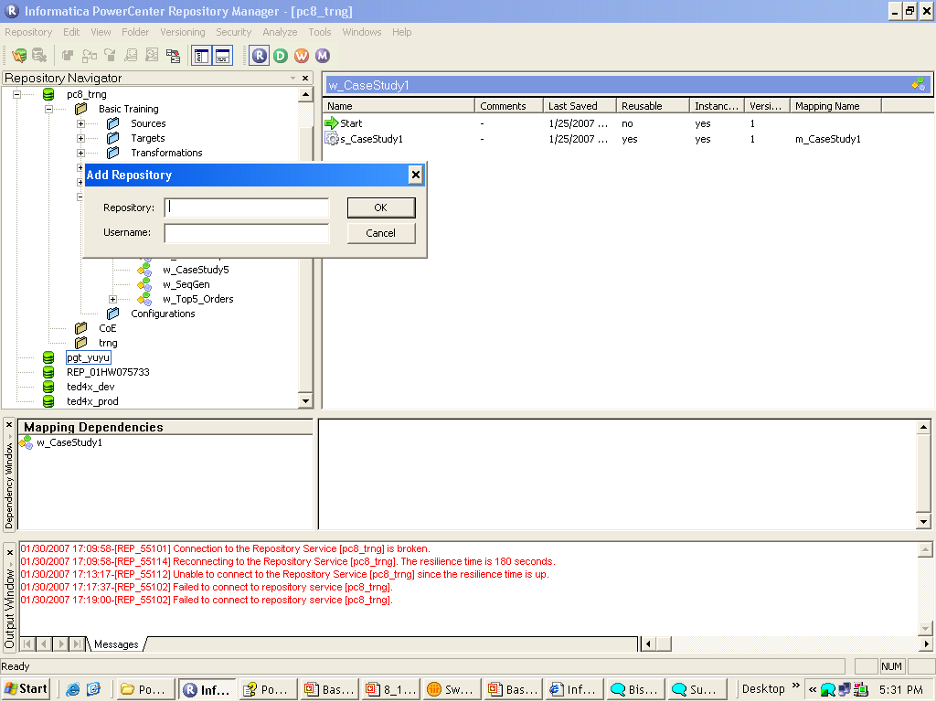
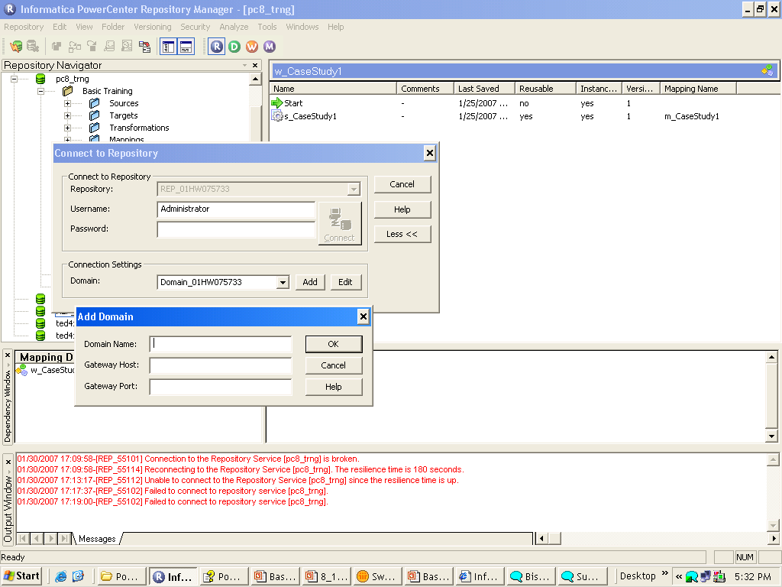
Add Repository
STEP 1: Add Repository
STEP 2: Mention the Repository Name and Username
STEP 3: Add Domain & Its Settings

Slide 20
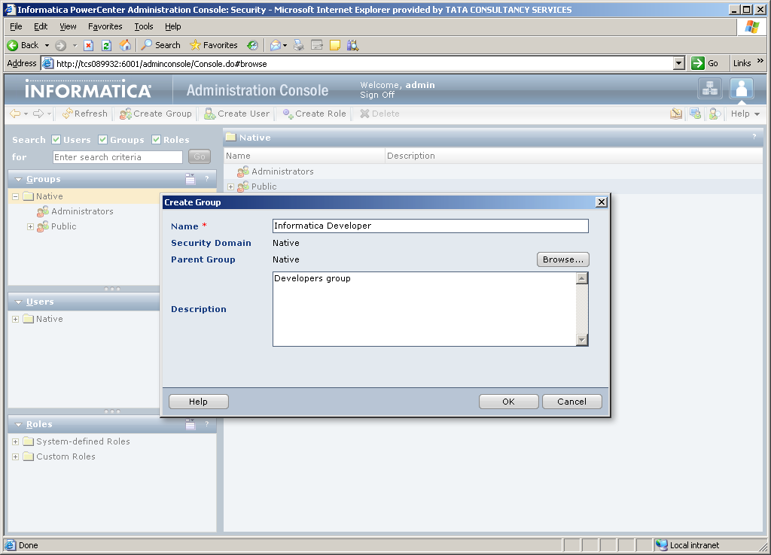
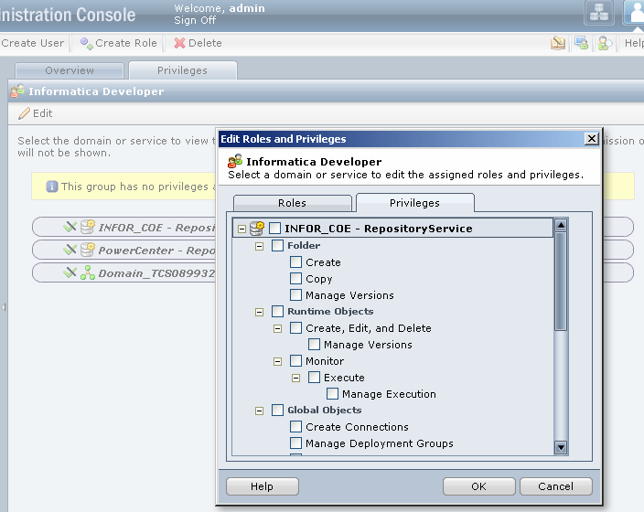
Users & Groups
Steps:
Create groups
Create users
Assign users to groups
Assign privileges to groups
Assign additional privileges to users (optional)

Slide 21
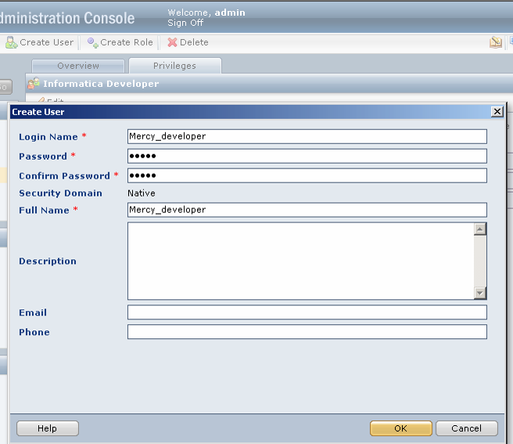
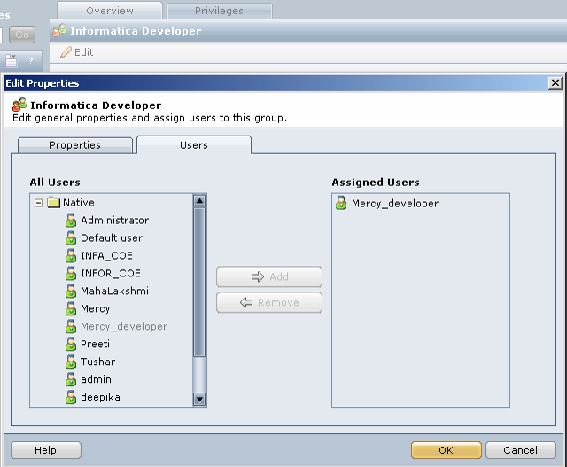
Users & Groups

Slide 22
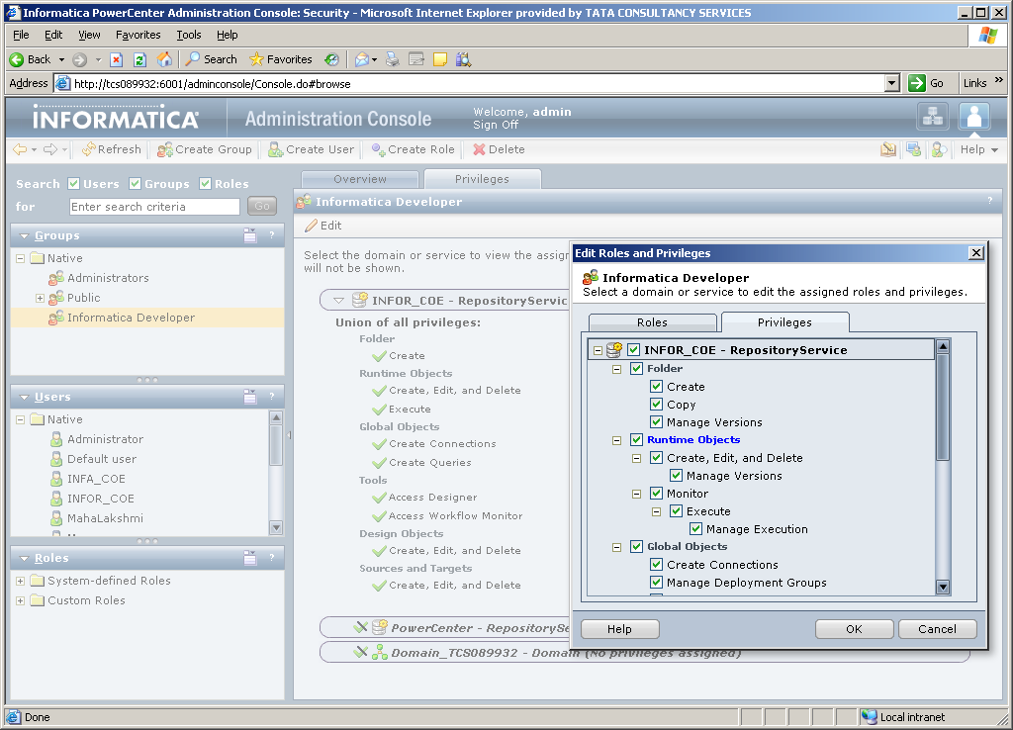
Managing Privileges
Check box assignment of privileges

Slide 23
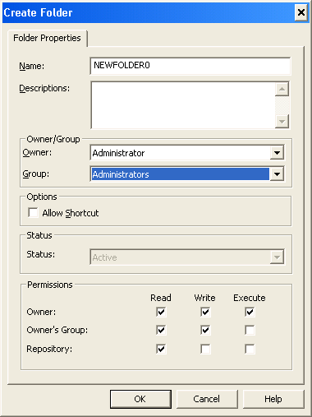
Folder Permissions
Assign one user as the folder owner for first tier permissions
Select one of the owner’s groups for second tier permissions
All users and groups in the Repository will be assigned the third tier permissions

Slide 24
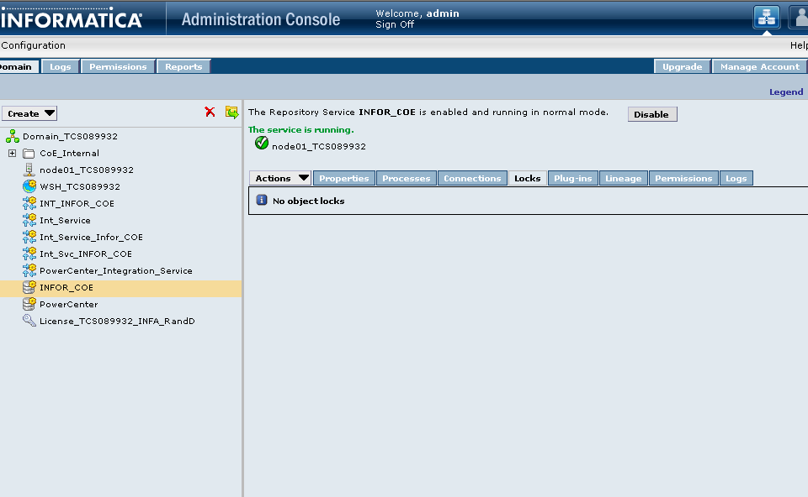
Object Locking
Object Locks preserve Repository integrity
Use the Edit menu for Viewing Locks and Unlocking Objects

Slide 25
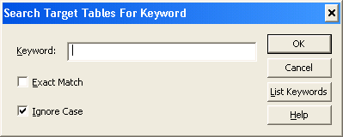
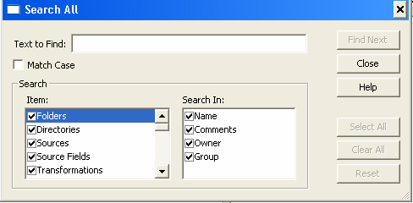
Object Searching
Menu -> Analyze –> Search
Keyword search
Used when a keyword is associated with a target definition
Search all
Filter and search objects
Notes:
The Object searching is another tool which may come handy in many situations during the project. The searching greatly helps when the environment is too huge with large number of folders and mappings. It may also help to determine dependencies among the objects through the environment.

Slide 26
Object Sharing
Reuse existing objects
Enforces consistency
Decreases development time
Share objects by using copies and shortcuts
Required security settings for sharing objects:
Repository Privilege: Use Designer
Originating Folder Permission: Read
Destination Folder Permissions: Read/Write
COPY | SHORTCUT
Copy object to another folder | Link to an object in another folder or repository
Changes to original object not captured | Dynamically reflects changes to original object
Duplicates space | Preserves space
Copy from shared or unshared folder | Created from a shared folder
Notes:
The copy object may be more beneficial in cases where the copied object may needed to be edited according to the need. In that case we may don’t want to start from scratch and copies a similar object and edit it accordingly.
In an another scenario copying may be more appropriate where we have say a repository onsite and a repository offshore which are very far. A link here from one repository to another may not be feasible choice performance wise.
A shortcut may be more handy in a scenario say where we have global and local repositories. The objects in local repositories may have links i.e. shortcuts to the objects in global repository.

Slide 27
Adding Metadata Extensions
Allows developers and partners to extend the metadata stored in the Repository
Accommodates the following metadata types:
Vendor-defined - Third-party application vendor-created metadata lists
For example, Applications such as Ariba or PowerConnect for Siebel can add information such as contacts, version, etc.
User-defined - PowerCenter users can define and create their own metadata
Must have Administrator Repository or Super User Repository privileges

Slide 28
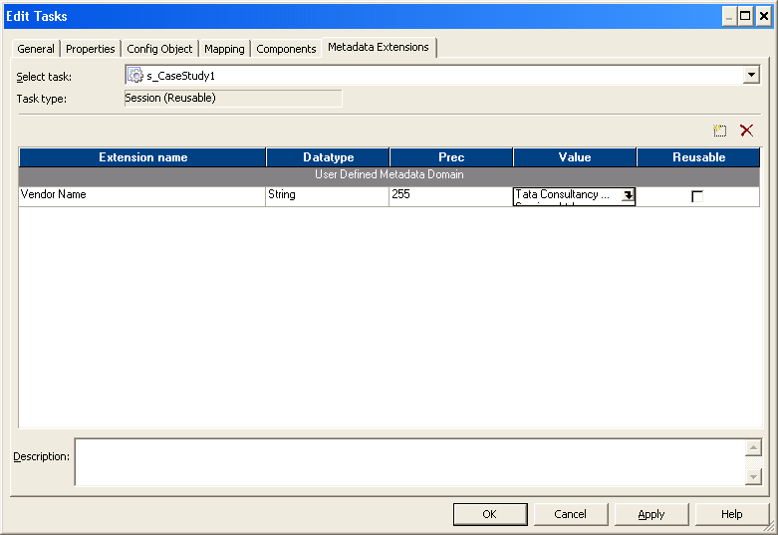
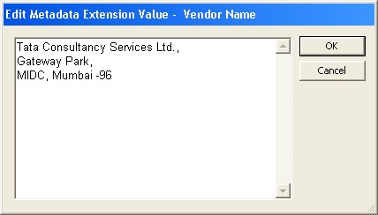
Sample Metadata Extensions
Sample User Defined Metadata, e.g. - contact information, business user
Reusable Metadata Extensions can also be created in the Repository Manager

Slide 29
Introduction to PowerCenter Design Process

Slide 30
We will walk through -
Design Process
PowerCenter Designer Interface
Mapping Components

Slide 31
Design Process
Create Source definition(s)
Create Target definition(s)
Create a Mapping
Create a Session Task
Create a Workflow from Task components
Run the Workflow
Monitor the Workflow and verify the results
Notes:
Through the design process all the concepts of previous slides can be made more clear starting from source definitions to monitoring and verifying the workflows.

Slide 32

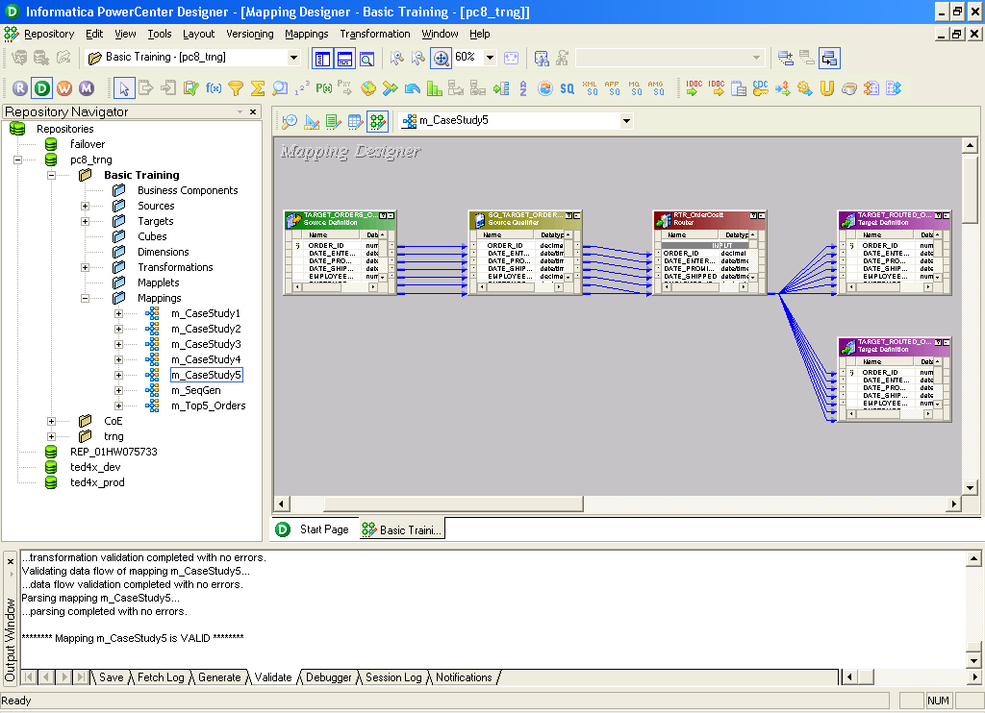
PowerCenter Designer- Interface
Overview Window
Client Tools
Navigator
Workspace
Output
Status Bar

Slide 33
Mapping Components
Each PowerCenter mapping consists of one or more of the following mandatory components
Sources
Transformations
Targets
The components are arranged sequentially to form a valid data flow from Sources→Transformations→Targets

Slide 34
Introduction To PowerCenter Designer Interface

Slide 35
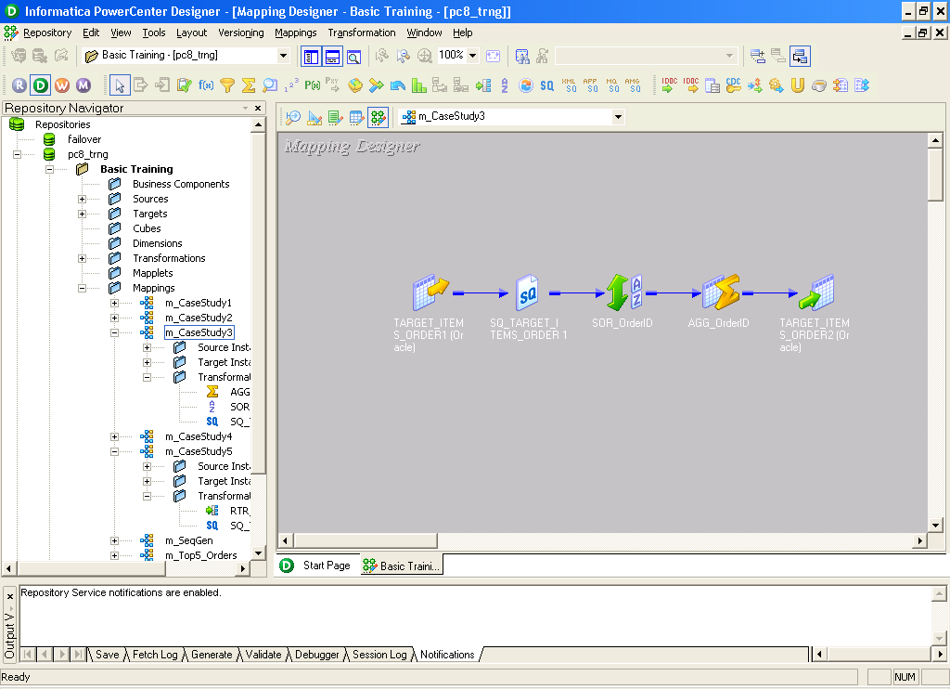
PowerCenter Designer- Interface
Mapping List
Folder List
Transformation Toolbar
Iconized Mapping

Slide 36
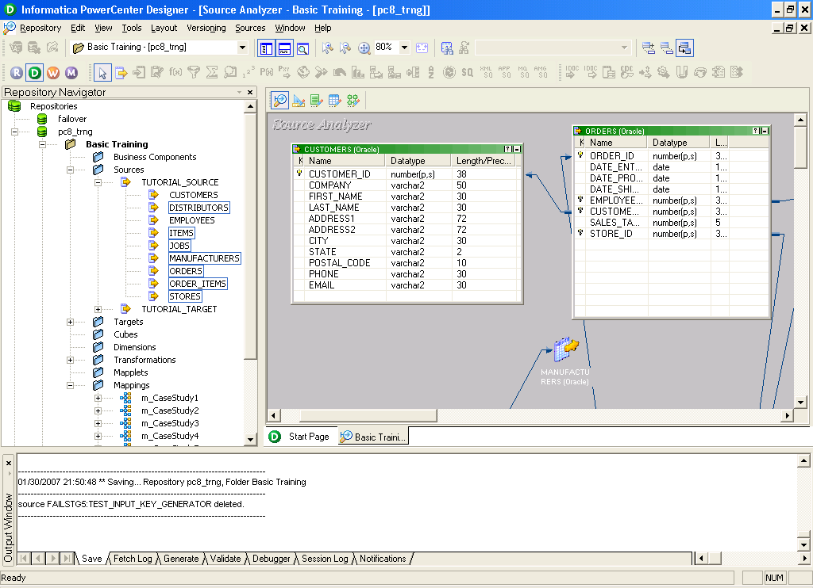
PowerCenter Designer- Source Analyzer
Foreign Key
It Shows the Dependencies of the tables also

Slide 37
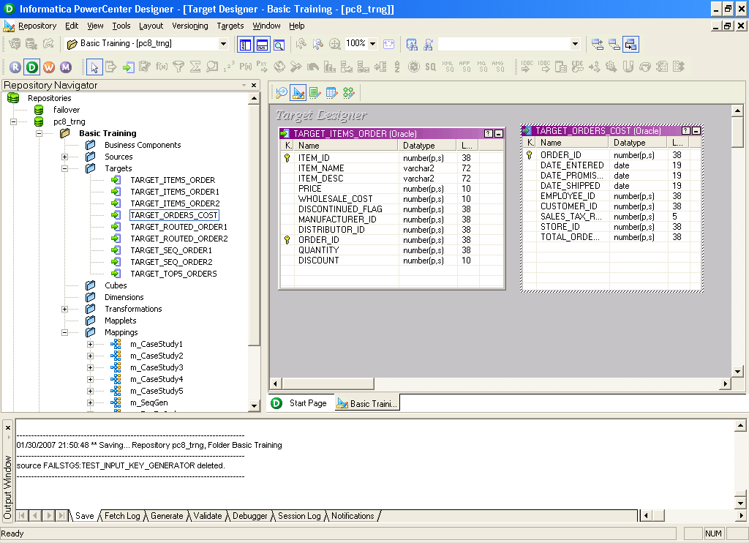

Slide 38
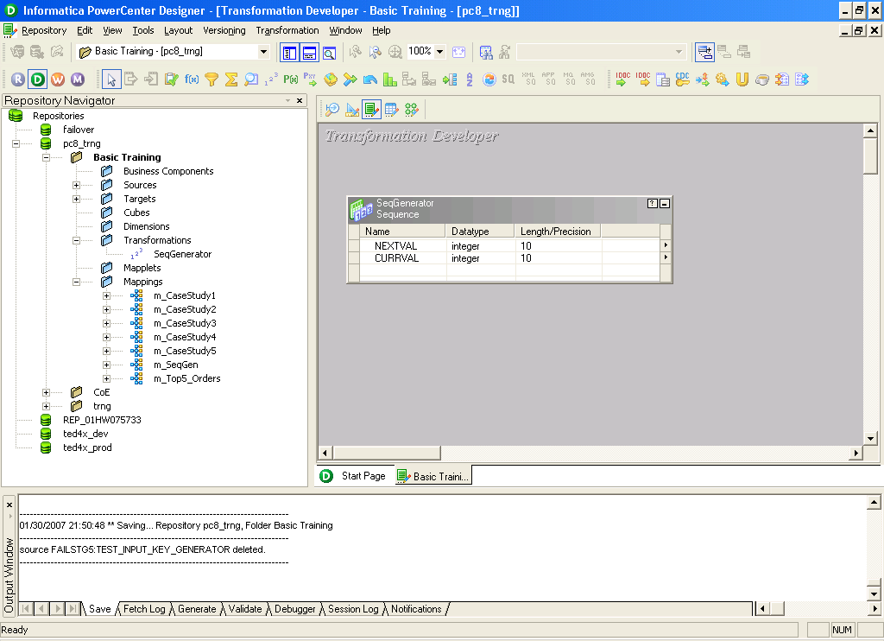
PowerCenter Designer- Transformation Developer
Transformation Developer is used only for creating reusable transformations

Slide 39
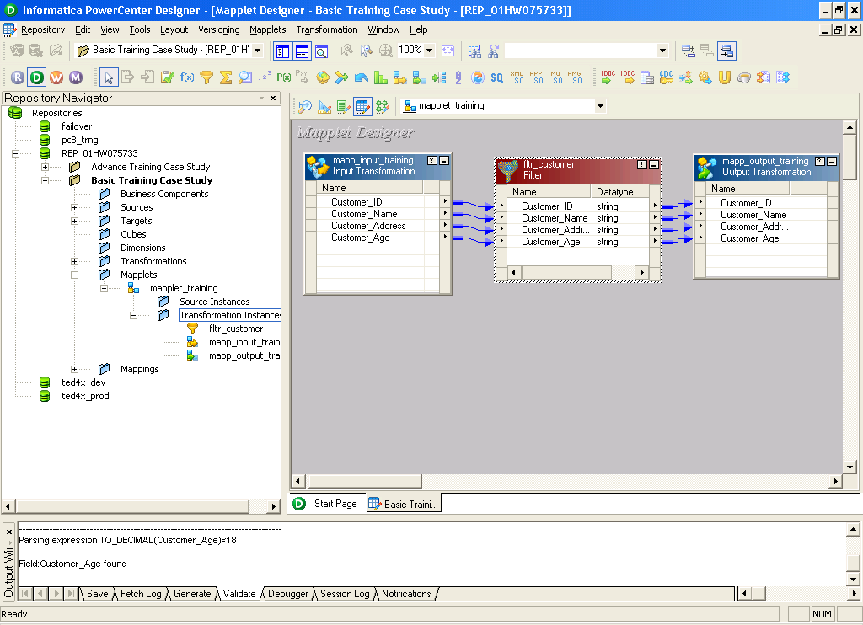
PowerCenter Designer- Mapplet Designer

Slide 40
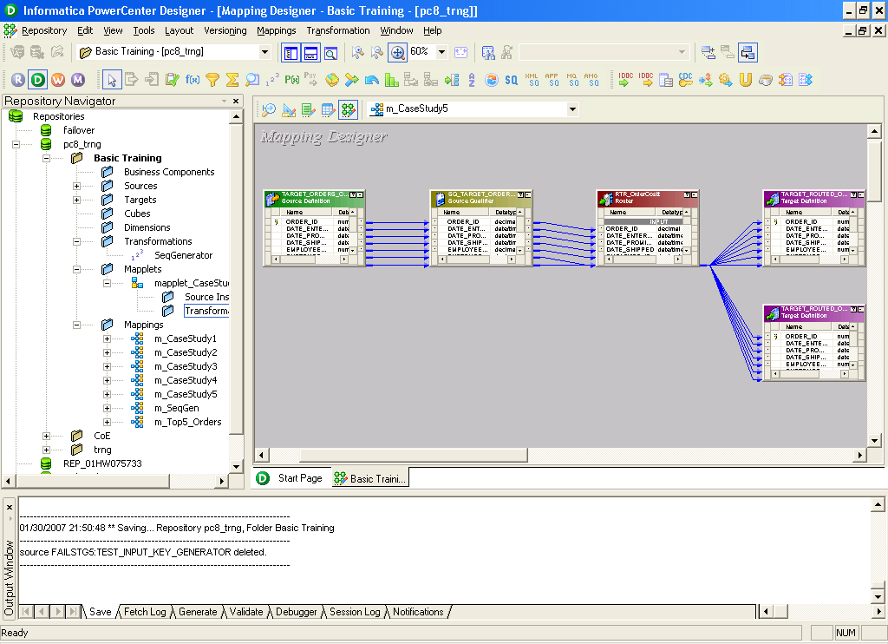
PowerCenter Designer- Mapping Designer

Slide 41
EXTRACT – Source Object Definitions

Slide 42
This section introduces to -
Different Source Types
Creation of ODBC Connections
Creation of Source Definitions
Source Definition properties
Data Preview option
Notes:
The key aspect of understanding the source definitions is ‘how they related to the extraction process’ and ‘how they are used to analyze the data’.
Data preview option is really helpful in viewing the data without specifically logging to the database to see the data. Data Preview helps in determining the type of the data and analyzing it. The data Preview option also helps in debugging purposes wherein we can trace the data through the dataflow sequence.

Slide 43
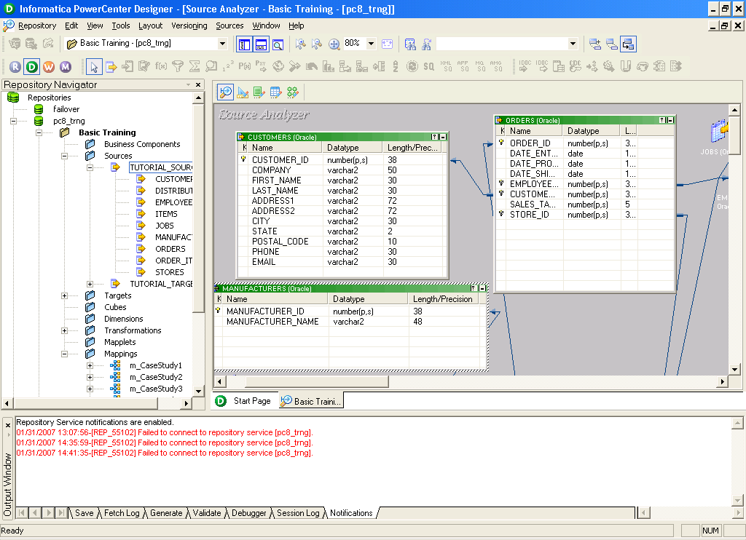
Source Analyzer
Navigation Window
Analyzer Window

Slide 44
Methods of Analyzing Sources
Import from Database
Import from File
Import from Cobol File
Import from XML file
Import from third party software like SAP, Siebel, PeopleSoft etc
Create manually
Repository
Source Analyzer
Relational
XML file
Flat file
COBOL file
Notes:
Source definitions describe the sources that are going to be providing data to the warehouse. There are five different ways to create source definitions in the repository:
Import from Database - reverse engineer object definitions from database catalogs such as Informix, Sybase, Microsoft SQL Server, Oracle, DB2, or ODBC sources
Import from File - use the PowerMart / PowerCenter Flat File Wizard to analyze an ASCII file
Import from COBOL File - use COBOL data structures
Import from XML – use XML elements and attributes structures
Create manually - can create any of the above definition types manually
Transfer from data modeling tools (Erwin, PowerDesigner, S-Designor, Designer/2000) via PowerPlugs.
Note: PowerMart / PowerCenter provides additional Source input via separate ERP PowerConnect products for SAP, PeopleSoft, Seibel.

Slide 45

Analyzing Relational Sources
Source Analyzer
Relational Source
ODBC
Table
View
Synonym
DEF
TCP/IP
Repository
Service
native
Repository
DEF
Notes:
The Source Analyzer connects to the source database via Open Database Connectivity (ODBC), extracts the information, and puts it in the Repository.
The Source Analyzer will extract definitions of relational tables, views, and synonyms from a database catalog. The extracted information includes table name, column name, length, precision, scale, and primary/foreign key constraints. Primary/foreign key constraints will not be extracted for views and synonyms.
Primary/foreign key relationships between sources can either be read from the source catalog, or later they can be defined manually within the Source Analyzer. Relationships need not exist physically in the source database, only logically in the repository.
Notes for faculty: Demonstrate creation of ODBC connection for fetching metadata from the source schema.

Slide 46
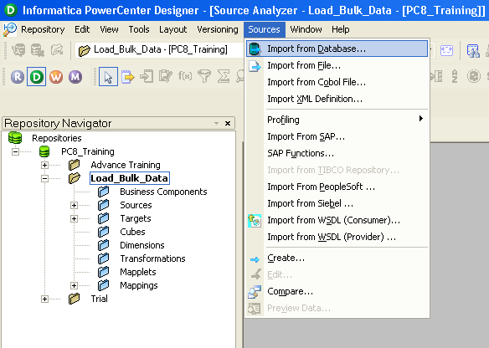
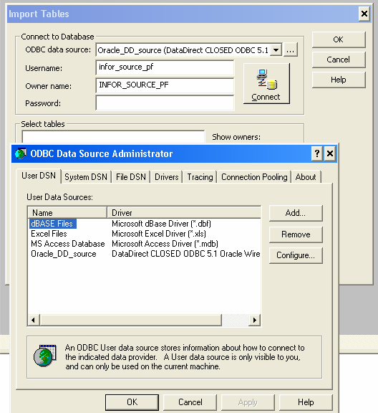
Importing Relational Sources
Step 1: Select “Import from Database”
Note: Use Data Direct ODBC Drivers than native drivers for creating ODBC connections
Step 2: Select/Create the ODBC Connection

Slide 47
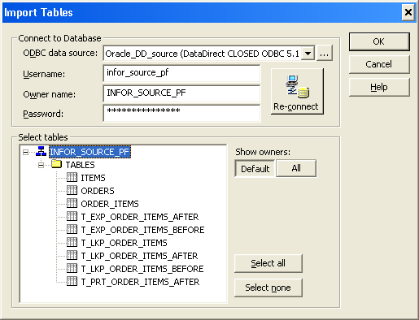
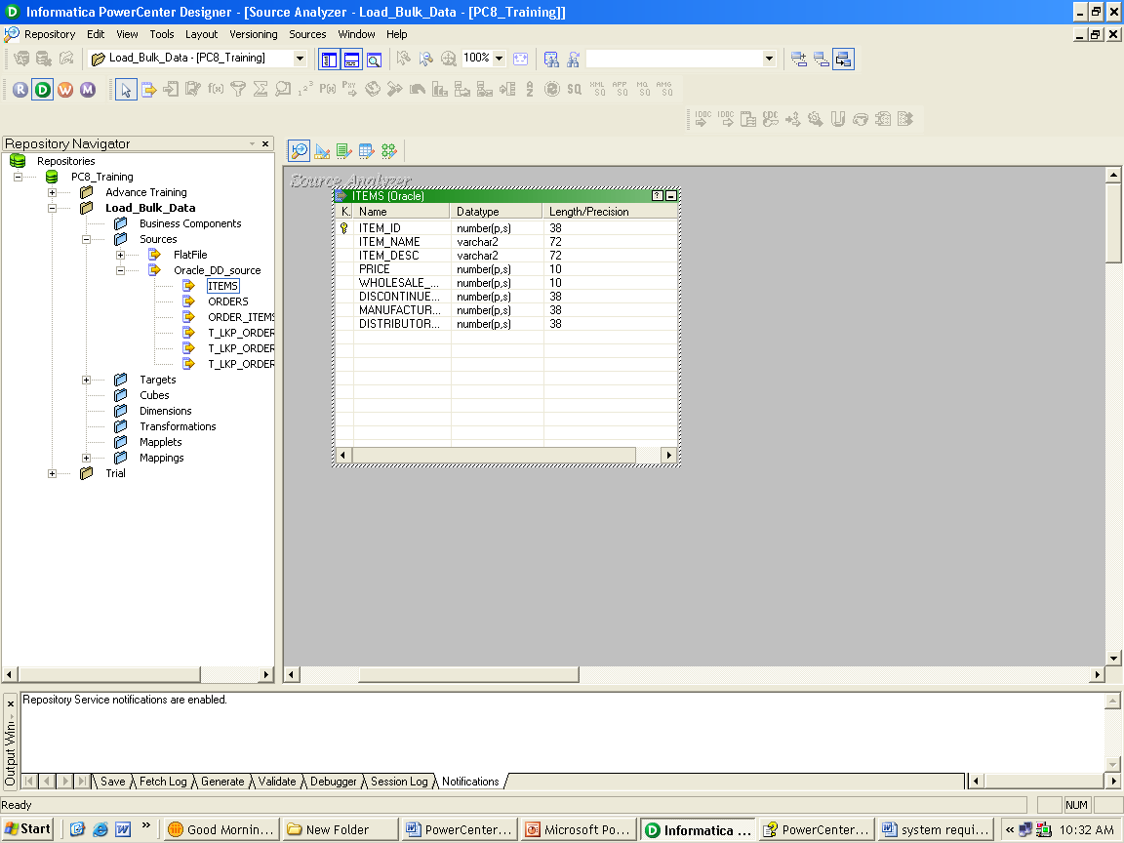
Importing Relational Sources
Step 3: Select the Required Tables
Step 4: Table Definition is Imported

Slide 48
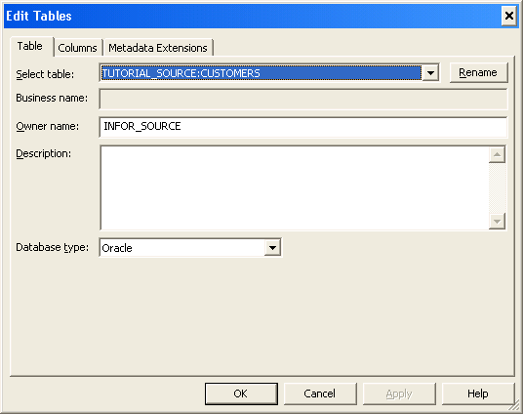
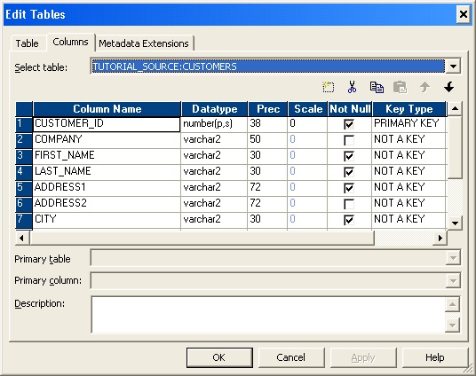
Analyzing Relational Sources
Editing Source Definition Properties
Key Type

Slide 49

Analyzing Flat File Sources
Source Analyzer
Mapped Drive
NFS Mount
Local Directory
Flat File
DEF
Fixed Width or
Delimited
TCP/IP
Repository
Service
native
Repository
DEF
Notes:
The Source Analyzer provides a wizard for analyzing flat files. Files can be either fixed-width or delimited. If the file contains binary data, then the file must be fixed-width and the Flat File Wizard cannot be used to analyze the file.
You can analyze the file via a mapped network drive to the file, an NFS mount to the file, or the file can reside locally on the workstation. The latter is probably unlikely due to the size of the flat file.
For best performance at runtime, place files on the server machine. You can also use a mapped drive, NFS mounting, or FTP files from remote machines.

Slide 50
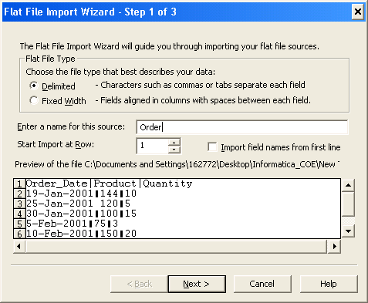
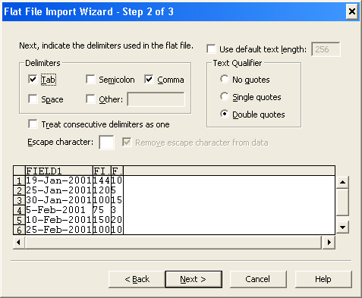
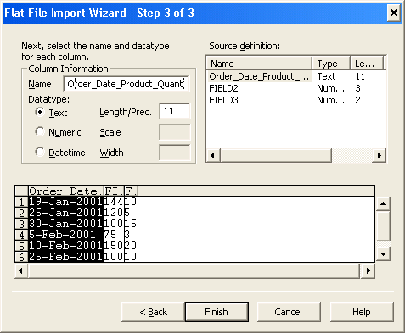
Flat File Wizard
Three-step wizard
Columns can be renamed within wizard
Text, Numeric and Datetime datatypes are supported
Wizard ‘guesses’ datatype
Notes:
Using the Import from File menu option invokes the Flat File Wizard. Some tips on using the wizard include:
The wizard automatically gives the flat file source definition the name of the file (excluding the extension), which can be changed. This is the name under which the source definition will be stored in the Repository.
Don’t use a period (.) in the source definition name.
The first row can be used to name the columns in a source definition.
You need to click on another column to set any changes made under Column Information.
Once a flat file source definition has been created (either through the Flat File Wizard or manually), the flat file attributes can be altered through the Edit Table dialog, as seen on the next slide. With flat files there is more flexibility in changing the table or column names, as PowerMart / PowerCenter uses the record layout of the file to extract data. Once mappings are created, the rules for validation and re-analyzing are the same as for relational sources

Slide 51

XML Source Analysis
Source Analyzer
.DTD File
Mapped Drive
NFS Mounting
Local Directory
DEF
TCP/IP
DATA
Repository
Service
In addition to the DTD file, an
XML Schema or XML file can be used as a Source Definition
native
Repository
DEF
Notes:
You can import a source definition from the following XML sources:
XML files
DTD files
XML schema files
When you import a source definition based on an XML file that does not have an associated DTD, the Designer determines the types and occurrences of the data based solely on data represented in the XML file. To ensure that the Designer can provide an accurate definition of your data, import from an XML source file that represents the occurrence and type of data as accurately as possible.
When you import a source definition from a DTD or an XML schema file, the Designer can provide an accurate definition of the data based on the description provided in the DTD or XML schema file.
The Designer represents the XML hierarchy from XML, DTD, or XML schema files as related logical groups with primary and foreign keys in the source definition. You can have the Designer generate groups and primary keys, or you can create your own groups and specify keys.
The Designer saves the XML hierarchy and the group information to the repository. It also saves the cardinality and datatype of each element in the hierarchy. It validates any change you make to the groups against the XML hierarchy. It does not allow any change that is not consistent with the hierarchy or that breaks the rules for XML groups. For more information on XML groups, cardinality, and datatypes, see XML Concepts.
When you import an XML source definition, your ability to change the cardinality and datatype of the elements in the hierarchy depends on the type of file you are importing. You cannot change the cardinality of the root element since it only occurs once in an XML hierarchy. You also cannot change the cardinality of an attribute since it only occurs once within a group.
When you import an XML source definition, the Designer disregards any encoding declaration in the XML file. The Designer instead uses the code page of the repository.

Slide 52
Analyzing VSAM Sources
Source Analyzer
.CBL File
Mapped Drive
NFS Mounting
Local Directory
DEF
TCP/IP
DATA
Repository
Service
Supported Numeric Storage Options:
COMP, COMP-3, COMP-6
native
Repository
DEF
Notes:
PowerMart / PowerCenter can use a physical sequential copy of a VSAM file as a source. The file may contain numeric data stored in binary or packed decimal columns.
The data structures stored in a COBOL program’s Data Division File Section can be used to create a source definition describing a VSAM source. The entire COBOL program is not needed. A basic template plus the File Definition (FD) section can be saved in a text file with a .cbl extension and placed where the client can access it. Try not to edit the COBOL file or copybook with Notepad or Wordpad. Always edit with a DOS editor to avoid hidden characters in the file.
If the COBOL file includes a copybook (.cpy) file with the actual field definitions, PowerMart / PowerCenter will look in the same location as the .cbl file. If it is not found in that directory, PowerMart / PowerCenter will prompt for the location.
Once the COBOL record definition has been read into the repository, PowerMart / PowerCenter stores it as a source type called ‘VSAM’. Mainframe datasets must be converted to physical sequential fixed-length record format. On MVS, this means Dsorg=PS, Recfm = FB. Once a data file is in that format it should be transferred in binary mode (unaltered) to the machine where the PowerMart / PowerCenter server is running. All COBOL COMP, COMP-3, and COMP-6 datatypes are read and interpreted.
PowerMart / PowerCenter provides COMP word-storage as a default. COMP columns are 2, 4 or 8 bytes on IBM mainframes. COMP columns can be 1, 2, 3, 4, 5, 6, 7 or 8 bytes elsewhere when derived through Micro Focus COBOL. There is VSAM/Flat File source definition option called IBM COMP, which is checked by default. If it is unchecked, PowerMart / PowerCenter switches to byte-storage which will work for VMS COBOL and MicroFocus COBOL-related data files.

Slide 53
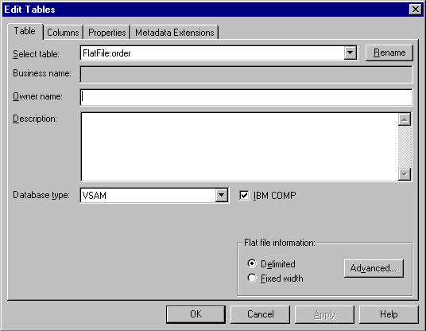
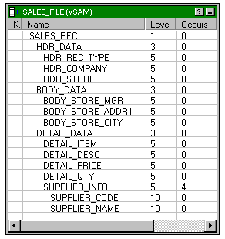
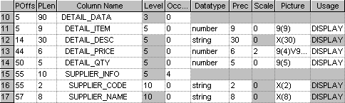
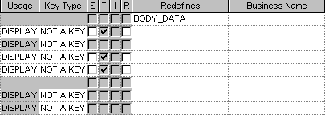
VSAM Source Properties
Notes:
VSAM attributes can be altered through the Edit Table dialog. With VSAM sources there is more flexibility in changing the table and column names, as PowerMart / PowerCenter uses the record layout of the file to extract data. Once mappings are created, the rules for validation and re-analyzing are the same as for relational sources. VSAM Column Attributes include:
Physical Offset (POffs) - the character/byte offset of the column in the file.
Physical Length (PLen) - the character/byte length of the column in the file.
Occurs - a number <n> that denotes that the column (record or column) is repeated <n> times. This is used by the Normalizer functionality to normalize repeating values.
Datatype - the only types in a VSAM source are string and number.
Precision (Prec) - total number of significant digits including those after the decimal point.
Scale - number of significant digits after the decimal point.
Picture - all columns that are not records must have a Picture (PIC) clause which describes the length and content type of the column.
Usage - the storage format for the column. The default usage for a column is DISPLAY.
Key Type - specifies if the column is a primary key.
Signed (S) - signifies a signed number (prepends an S to the Picture).
Trailing Sign (T) - denotes whether the sign is stored in the rightmost bits.
Included Sign (I) - denotes whether the sign is included or separate from the value.
Real Decimal point (R) - denotes whether the decimal point is real (.), otherwise the decimal point is virtual (V) in the Picture. Also known as explicit vs. implicit decimal.
Redefines - a label to denote shared storage.

Slide 54
LOAD – Target Definitions

Slide 55
Target Object Definitions
By the end of this section you will:
Be familiar with Target Definition types
Know the supported methods of creating Target Definitions
Understand individual Target Definition properties

Slide 57
Creating Target Definitions
Methods of creating Target Definitions
Import from Database
Import from an XML file
Import from third party software like SAP, Siebel etc.
Manual Creation
Automatic Creation
Notes:
The methods of creating target schema, which will be discussed on the next slides, are:
Automatic Creation
Import from Database
Manual Creation
Transfer from data modeling tools via PowerPlugs

Slide 58
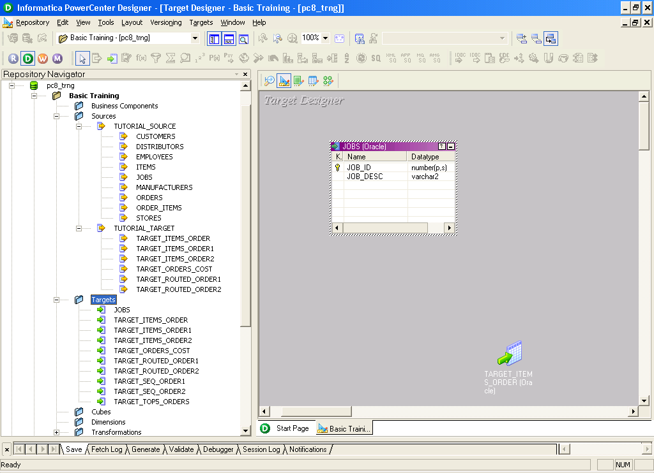
Automatic Target Creation
Drag-and-drop a Source Definition into the Target Designer Workspace
Notes:
Dragging and dropping a source definition from the Navigator window to the Warehouse Designer workbook automatically creates a duplicate of the source definition as a target definition. Target definitions are stored in a separate section of the repository.
Automatic target creation is useful for creating:
Staging tables, such as those needed in Dynamic Data Store
Target tables that will mirror much of the source definition
Target tables that will be used to migrate data from different databases, e.g., Sybase to Oracle
Target tables that will be used to hold data coming from VSAM sources.

Slide 59
Import Definition from Database
Can “Reverse engineer” existing object definitions from a database system catalog or data dictionary
Target Designer
Database
ODBC
Table
View
Synonym
TCP/IP
DEF
Repository
Service
native
Repository
DEF
Notes:
Sometimes, target tables already exist in a database, and you may want to reverse engineer those tables directly into the PowerMart / PowerCenter repository. In this case, it will not be necessary to physically create those tables unless they need to be created in a different database location.
Notes for faculty: Demonstrate creation of ODBC connection for fetching metadata from the target schema.

Slide 60
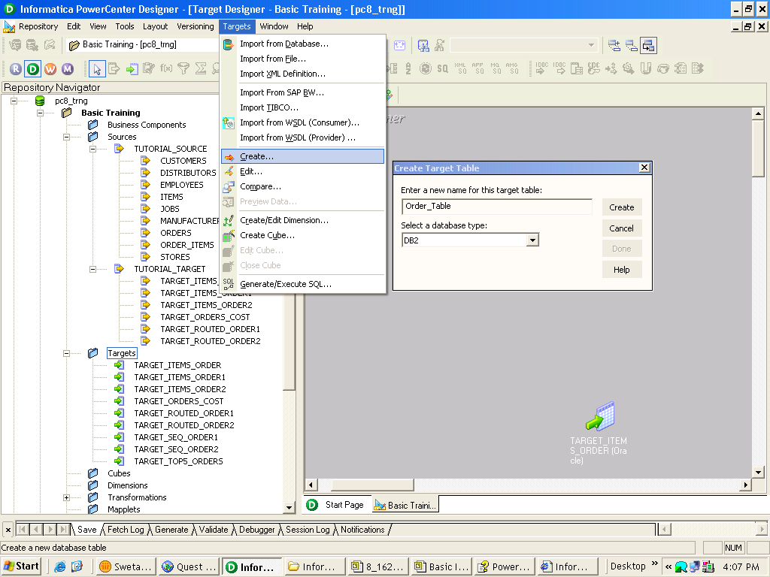
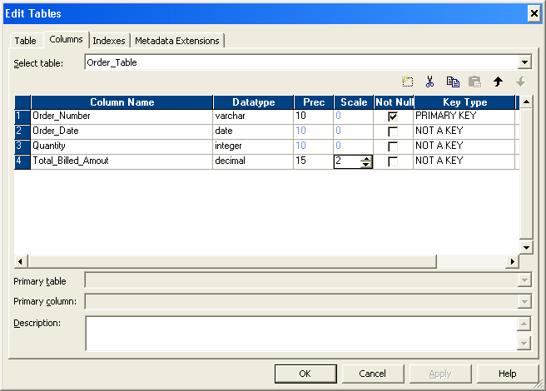
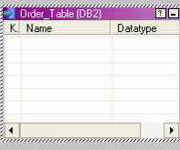
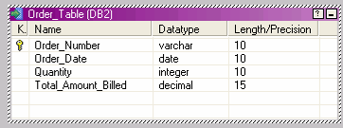
Manual Target Creation
1. Create empty definition
2. Add desired columns
3. Finished target definition
ALT-F can also be used to create a new column

Slide 61
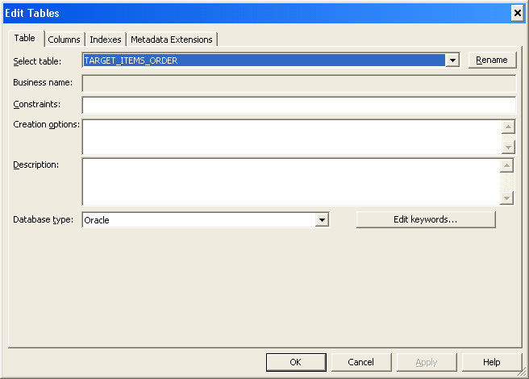
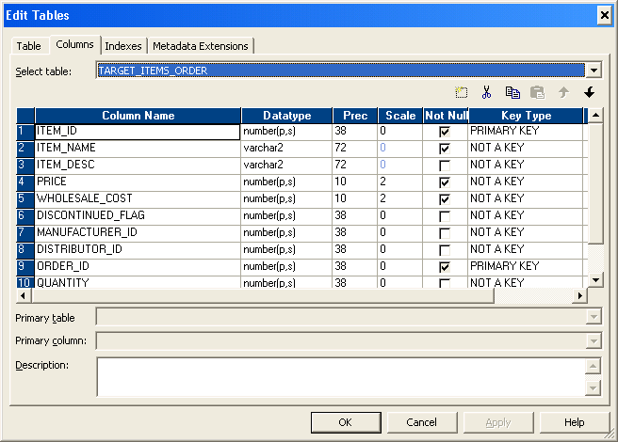
Target Definition Properties
Notes:
Once you have created your target definitions, PowerMart / PowerCenter allows you to edit these definitions by double-clicking on the target definition in the Warehouse Designer workspace or by selecting the target definition in the workspace and choosing Targets | Edit. While in Edit mode, you can also choose to edit another target definition in the workspace by using the pull-down menu found by the Select Table box.
Under the Table tab, you can add:
Business names - to add a more descriptive name to a table name
Constraints - SQL statements for table level referential integrity constraints
Creation options - SQL statements for table storage options
Descriptions - to add comments about a table
Keywords - to organize target definitions. With the repository manager, you can search the repository for keywords to find a target quickly.
Under the Columns tab, there are the usual settings for column names, datatypes, precision, scale, null ability, key type, comments, and business names. Note that you cannot edit column information for tables created in the Dimension and Fact Editors.
Under the Indexes tab, you can logically create an index and specify what columns comprise the index. When it is time to generate SQL for the table, enable the Create Index option to generate the SQL to create the index.

Slide 62
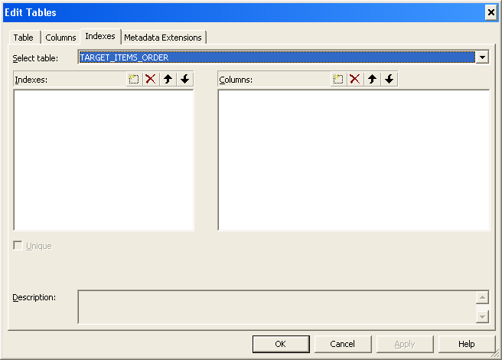
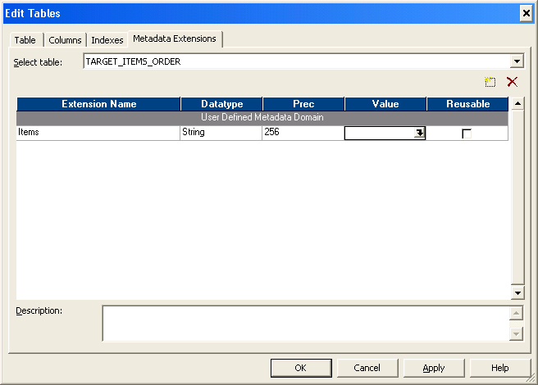

Target Definition Properties

Slide 63
Creating Physical Tables
DEF
DEF
DEF
Execute SQL
via
Designer
LOGICAL
Repository target table definitions
PHYSICAL
Target database tables
Notes:
Once you have finished the design of their target tables, it is necessary to generate and execute SQL to physically create the target tables in the database (unless the table definitions were imported from existing tables).
The ‘Designer’ connects to the database through ODBC can run the SQL scripts in the database for the specified target definition. Thus, the definition is created in the database specified without ‘actually’ going to the database.

Slide 64

Creating Physical Tables
Create tables that do not already exist in target database
Connect - connect to the target database
Generate SQL file - create DDL in a script file
Edit SQL file - modify DDL script as needed
Execute SQL file - create physical tables in target database
Use Preview Data to verify the results (right mouse click on object)

Slide 65
TRANSFORM – Transformation Concepts

Slide 66
Transformation Concepts
By the end of this section you will be familiar with:
Transformation types
Data Flow Rules
Transformation Views
PowerCenter Functions
Expression Editor and Expression validation
Port Types
PowerCenter data types and Datatype Conversion
Connection and Mapping Valdation
PowerCenter Basic Transformations – Source Qualifier, Filter, Joiner, Expression

Slide 67
Types of Transformations
Active/Passive
Active : Changes the numbers of rows as data passes through it
Passive: Passes all the rows through it
Connected/Unconnected
Connected : Connected to other transformation through connectors
Unconnected : Not connected to any transformation. Called within a transformation

Slide 68
Transformation Types
PowerCenter 8.6 provides 24 objects for data transformation
Aggregator: performs aggregate calculations
Application Source Qualifier: reads Application object sources as ERP
Custom: Calls a procedure in shared library or DLL
Expression: performs row-level calculations
External Procedure (TX): calls compiled code for each row
Filter: drops rows conditionally
Mapplet Input: Defines mapplet input rows. Available in Mapplet designer
Java: Executes java code
Joiner: joins heterogeneous sources
Lookup: looks up values and passes them to other objects
Normalizer: reads data from VSAM and normalized sources
Mapplet Output: Defines mapplet output rows. Available in Mapplet designer

Slide 69
Transformation Types
Rank: limits records to the top or bottom of a range
Router: splits rows conditionally
Sequence Generator: generates unique ID values
Sorter: sorts data
Source Qualifier: reads data from Flat File and Relational Sources
Stored Procedure: calls a database stored procedure
Transaction Control: Defines Commit and Rollback transactions
Union: Merges data from different databases
Update Strategy: tags rows for insert, update, delete, reject
XML Generator: Reads data from one or more Input ports and outputs XML through single output port
XML Parser: Reads XML from one or more Input ports and outputs data through single output port
XML Source Qualifier: reads XML data

Slide 70

Data Flow Rules
Each Source Qualifier starts a single data stream (a dataflow)
Transformations can send rows to more than one transformation (split one data flow into multiple pipelines)
Two or more data flows can meet together -- if (and only if) they originate from a common active transformation
Cannot add an active transformation into the mix
ALLOWED
DISALLOWED
Passive
Active
T
T
T
T
Example holds true with Normalizer in lieu of Source Qualifier. Exceptions are: Mapplet Input and Joiner transformations

Slide 71



Transformation Views
A transformation has
three views:
Iconized - shows the transformation in relation to the rest of the mapping
Normal - shows the flow of data through the transformation
Edit - shows transformation ports and properties; allows editing
Notes:
Iconizing transformations can help minimize the screen space needed to display a mapping.
Normal view is the mode used when copying/linking ports to other objects.
Edit view is the mode used when adding, editing, or deleting ports, or changing any of the transformation attributes or properties.

Slide 72

Edit Mode
Allows users with folder “write” permissions to change or create transformation ports and properties
Define port level handling
Define transformation level properties
Enter comments
Make reusable
Switch between transformations
Notes:
Each transformation has a minimum of three tabs:
Transformation - allows you to rename a transformation, switch between transformations, enter transformation comments, and make a transformation reusable
Ports - allows you to specify port level attributes such as port name, datatype, precision, scale, primary/foreign keys, nullability
Properties - allows you to specify the amount of detail in the session log, and other properties specific to each transformation.
On certain transformations, you will find other tabs such as:
Condition
Sources
Normalizer.

Slide 73



Expression Editor
An expression formula is a calculation or conditional statement
Used in Expression, Aggregator, Rank, Filter, Router, Update Strategy
Performs calculation based on ports, functions, operators, variables, literals, constants and return values from other transformations
Notes:
An expression is a calculation or conditional statement added to a transformation. These expressions use the PowerMart / PowerCenter transformation language that contains many functions designed to handle common data transformations. For example, the TO_CHAR function can be used to convert a date into a string, or the AVG function can be used to find the average of all values in a column. While the transformation language contains functions like these familiar to SQL you, other functions, such as MOVINGAVG and CUME, exist to meet the special needs of data marts.
An expression can be composed of ports (input, input/output, variable), functions, operators, variables, literals, return values, and constants. Expressions can be entered at the port or transformation level in the following transformation objects:
Expression - output port level
Aggregator - output port level
Rank - output port level
Filter - transformation level
Update Strategy - transformation level
Expressions are built within the Expression editor. The PowerMart / PowerCenter transformation language is found under the Functions tab, and a list of available ports, both remote and local, is found under the Ports tab. If a remote port is referenced in the expression, the Expression editor will resolve the remote reference by adding and connecting a new input port in the local transformation.
Comments can be added to expressions by prefacing them with ‘--’ or ‘//’. If a comment continues onto a new line, start the new line with another comment specifier.

Slide 74

PowerCenter Data Types
NATIVE DATATYPES | TRANSFORMATION DATATYPES
Specific to the source and target database types | PowerCenter internal datatypes based on ANSI SQL-92
Display in source and target tables within Mapping Designer | Display in transformations within Mapping Designer
Native
Transformation
Native
Transformation datatypes allow mix and match of source and target database types
When connecting ports, native and transformation datatypes must be compatible (or must be explicitly converted)
Notes:
When the Integration Service reads data from a source, it converts the native datatypes to the compatible transformation datatypes. When it runs a session, it performs transformations based on the transformation datatypes. When the Integration Service writes data to a target, it converts the data based on the target table’s native datatypes.
The transformation datatypes support most native datatypes. There are, however, a few exceptions and limitations.
PowerCenter does not support user-defined datatypes.
PowerCenter supports raw binary datatypes for Oracle, Microsoft SQL Server, and Sybase. It does not support binary datatypes for Informix, DB2, VSAM, or ODBC sources (such as Access97). PowerCenter also does not support long binary datatypes, such as Oracle’s Long Raw.
For supported binary datatypes, users can import binary data, pass it through the Integration Service, and write it to a target, but they cannot perform any transformations on this type of data.
For numeric data, if the native datatype supports a greater precision than the transformation datatype, the Integration Service rounds the data based on the transformation datatype.
For text data, if the native datatype is longer than the transformation datatype maximum length, the Integration Service truncates the text to the maximum length of the transformation datatype.
Date values cannot be passed to a numeric function.
You can convert strings to dates by passing strings to a date/time port; however, strings must be in the default date format.

Slide 75
Datatype Conversions
 | Integer, Small Int | Decimal | Double, Real | String , Text | Date/ Time | Binary
Integer, Small Integer | X | X | X | X
Decimal | X | X | X | X
Double , Real | X | X | X | X
String , Text | X | X | X | X | X
Date/Time |  |  |  | X | X
Binary |  |  |  |  |  | X
All numeric data can be converted to all other numeric datatypes, e.g. - integer, double, and decimal
All numeric data can be converted to string, and vice versa
Date can be converted only to date and string, and vice versa
Raw (binary) can only be linked to raw
Other conversions not listed above are not supported
These conversions are implicit; no function is necessary
Notes:
Data can be converted from one datatype to another by:
Passing data between ports with different datatypes (port-to-port conversion)
Passing data from an expression to a port (expression-to-port conversion)
Using transformation functions
Using transformation arithmetic operators
The transformation Decimal datatype supports precision up to 28 digits and the Double datatype supports precision of 15 digits. If the Server gets a number with more than 28 significant digits, the Server converts it to a double value, rounding the number to 15 digits. To ensure precision up to 28 digits, assign the transformation Decimal datatype and select Enable decimal arithmetic when configuring the session.

Slide 76
PowerCenter Functions - Types
ASCII
CHR
CHRCODE
CONCAT
INITCAP
INSTR
LENGTH
LOWER
LPAD
LTRIM
RPAD
RTRIM
SUBSTR
UPPER
REPLACESTR
REPLACECHR
Character Functions
Used to manipulate character data
CHRCODE returns the numeric value (ASCII or Unicode) of the first character of the string passed to this function
For backwards compatibility only - use || instead
Notes:
CHRCODE is a new function, which returns the character decimal representation of the first byte of the character passed to this function.
When you configure the Integration Service to run in ASCII mode, CHRCODE returns the numeric ASCII value of the first character of the string passed to the function. When you configure the PowerMart / PowerCenter Server to run in Unicode mode, CHRCODE returns the numeric Unicode value of the first character of the string passed to the function.

Slide 77
PowerCenter Functions
TO_CHAR (numeric)
TO_DATE
TO_DECIMAL
TO_FLOAT
TO_INTEGER
TO_NUMBER
Conversion Functions
Used to convert datatypes
Date Functions
Used to round, truncate, or compare dates; extract one part of a date; or perform arithmetic on a date
To pass a string to a date function, first use the TO_DATE function to convert it to an date/time datatype
ADD_TO_DATE
DATE_COMPARE
DATE_DIFF
GET_DATE_PART
LAST_DAY
ROUND (date)
SET_DATE_PART
TO_CHAR (date)
TRUNC (date)
Notes:
Several of the date functions include a format argument. The transformation language provides three sets of format strings to specify the argument. The functions TO_CHAR and TO_DATE each have unique date format strings. These transformation datatypes include a Date/Time datatype that supports datetime values up to the nanosecond.
Previous versions of PowerMart / PowerCenter internally stored dates as strings. PowerCenter now store dates internally in binary format which, in most cases, increases session performance. The new date format uses only 16 bytes per date, instead of 24, which reduces the memory required to store the date.
PowerCenter supports dates in the Gregorian Calendar system. Dates expressed in a different calendar system (such as the Julian Calendar) are not supported. However, the transformation language provides the J format string to convert strings stored in the Modified Julian Day (MJD) format to date/time values and date values to MJD values expressed as strings. The MJD for a given date is the number of days to that date since Jan 1st, 4713 B.C., 00:00:00 (midnight). Although MJD is frequently referred to as Julian Day (JD), MJD is different than JD. JD is calculated from Jan 1st, 4713 B.C., 12:00:00 (noon). So, for a given date, MJD - JD = 0.5. By definition, MJD includes a fractional part to specify the time component of the date. The J format string, however, ignores the time component.

Slide 78
PowerCenter Functions
Numerical Functions
Used to perform mathematical operations on numeric data
ABS
CEIL
CUME
EXP
FLOOR
LN
LOG
MOD
MOVINGAVG
MOVINGSUM
POWER
ROUND
SIGN
SQRT
TRUNC
Scientific Functions
Used to calculate geometric values of numeric data
COS
COSH
SIN
SINH
TAN
TANH

Slide 79
PowerCenter Functions
ERROR
ABORT
DECODE
IIF
Special Functions
Used to handle specific conditions within a session; search for certain values; test conditional statements
IIF(Condition,True,False)
ISNULL
IS_DATE
IS_NUMBER
IS_SPACES
Test Functions
Used to test if a lookup result is null
Used to validate data
SOUNDEX
METAPHONE
Encoding Functions
Used to encode string values

Slide 80
Expression Validation
The Validate or ‘OK’ button in the Expression Editor will:
Parse the current expression
Remote port searching (resolves references to ports in other transformations)
Parse transformation attributes
e.g. - filter condition, lookup condition, SQL Query
Parse default values
Check spelling, correct number of arguments in functions, other syntactical errors
Notes:
Rules for writing transformation expressions:
An expression can be composed of ports (input, input/output, variable), functions, operators, variables, literals, return values, and constants.
If you omit the source table name from the port name (e.g., you type ITEM_NO instead of ITEM.ITEM_NO), the parser searches for the port name. If it finds only one ITEM_NO port in the mapping, it creates an input port, ITEM_NO, and links the original port to the newly created port. If the parser finds more than one port named ITEM_NO, an error message displays. In this case, you need to use the Ports tab to add the correct ITEM_NO port.
Separate each argument in a function with a comma.
Except for literals, the transformation language is not case sensitive.
Except for literals, the parser and Integration Service ignore spaces.
The colon (:), comma (,), and period (.) have special meaning and should be used only to specify syntax.
A dash (-) is treated as a minus operator.
If you pass a literal value to a function, enclose literal strings within single quotation marks, but not literal numbers. The Integration Service treats any string value enclosed in single quotation marks as a character string.
Format string values for TO_CHAR and GET_DATE_PART are not checked for validity.
In the Call Text field for a source or target pre/post-load stored procedure, do not enclose literal strings with quotation marks, unless the string has spaces in it. If the string has spaces in it, enclose the literal in double quotes
Do not use quotation marks to designate input ports.
Users can nest multiple functions within an expression (except aggregate functions, which allow only one nested aggregate function). The Integration Service evaluates the expression starting with the innermost group.
Note: Using the point and click method of inserting port names in an expression will prevent most typos and invalid port names.

Slide 81
Types of Ports
Four basic types of ports are there
Input
Output
Input/Output
Variable
Apart from these Look-up & Return ports are also there that are specific to the Lookup transformation
Notes:
There are three kinds of ports: input, output and variable ports. The order of evaluation is not the same as the display order. The ordering of evaluation is first by port type, as described next.
Input ports are evaluated first. There is no ordering among input ports as they do not depend on any other ports.
After all input ports are evaluated, variable ports are evaluated next. Variable ports have to be evaluated after input ports, because variable expressions can reference any input port. variable port expressions can reference other variable ports but cannot reference output ports. There is ordering among variable evaluations, it is the same as the display order. Ordering is important for variables, because variables can reference each other's values.
Output ports are evaluated last. Output port expressions can reference any input port and any variable port, hence they are evaluated last. There is no ordered evaluation of output ports as they cannot reference each other.
Variable ports are initialized to either zero for numeric variables or empty string for character and date variables. They are not initialized to NULL, which makes it possible to do things like counters, for which an initial value is needed. Example: Variable V1 can have an expression like 'V1 + 1', which then behaves like a counter of rows. If the initial value of V1 was set to NULL, then all subsequent evaluations of the expression 'V1 + 1' would result in a null value.
Note: Variable ports have a scope limited to a single transformation and act as a container holding values to be passed to another transformation. Variable ports are different that mapping variables and parameters which will be discussed at a later point.

Slide 82



Variable and Output Ports
Use to simplify complex expressions
e.g. - create and store a depreciation formula to be referenced more than once
Use in another variable port or an output port expression
Local to the transformation (a variable port cannot also be an input or output port)
Available in the Expression, Aggregator and Rank transformations

Slide 83
Connection Validation
Examples of invalid connections in a Mapping:
Connecting ports with incompatible datatypes
Connecting output ports to a Source
Connecting a Source to anything but a Source Qualifier or Normalizer transformation
Connecting an output port to an output port or an input port to another input port
Connecting more than one active transformation to another transformation (invalid dataflow)
Notes:
If the Designer detects an error when trying to connect ports, it displays a symbol indicating that the ports cannot be connected. It also displays an error message in the status bar. When trying to connect ports, the Designer looks for the following errors:
Connecting ports with mismatched datatypes. The Designer checks if it can map between the two datatypes before connecting them. While the datatypes don't have to be identical (for example, Char and Varchar), they do have to be compatible.
Connecting output ports to a source. The Designer prevents you from connecting an output port to a source definition.
Connecting a source to anything but a Source Qualifier transformation. Every source must connect to a Source Qualifier or Normalizer transformation. Users then connect the Source Qualifier or Normalizer to targets or other transformations.
Connecting inputs to inputs or outputs to outputs. Given the logic of the data flow between sources and targets, you should not be able to connect these ports.
Connecting more than one active transformation to another transformation. An active transformation changes the number of rows passing through it. For example, the Filter transformation removes records passing through it, and the Aggregator transformation provides a single aggregate value (a sum or average, for example) based on values queried from multiple rows. Since the server cannot verify that both transformations will provide the same number of records, you cannot connect two active transformations to the same transformation.
Copying columns to a target definition. Users cannot copy columns into a target definition in a mapping. The Warehouse Designer is the only tool you can use to modify target definitions.

Slide 84

Mapping Validation
Mappings must:
Be valid for a Session to run
Be end-to-end complete and contain valid expressions
Pass all data flow rules
Mappings are always validated when saved; can be validated without being saved
Output Window will always display reason for invalidity
Notes:
Mappings can contain many types of problems. For example:
A transformation may be improperly configured.
An expression entered for a transformation may use incorrect syntax.
A target may not be receiving data from any sources.
An output port used in an expression no longer exists.
The Designer performs validation as you connect transformation ports, build expressions, and save mappings. The results of the validation appear in the Output window.

Slide 85

Source Qualifier Transformation
Reads data from the sources
Active & Connected Transformation
Applicable only to relational and flat file sources
Maps database/file specific datatypes to PowerCenter Native datatypes.
Eg. Number(24) becomes decimal(24)
Determines how the source database binds data when the Integration Service reads it
If mismatch between the source definition and source qualifier datatypes then mapping is invalid
All ports by default are Input/Output ports
Notes:
All the different types of source systems have their system specific data types. For example, Oracle has varchar2 as a datatype for character string, where are DB2 has char as data type. Source Qualifier is the interface that transforms these data types to native Informatica data types for efficient transformations and memory management.

Slide 86

Source Qualifier Transformation
Used as
Joiner for homogenous tables using a where clause
Filter using a where clause
Sorter
Select distinct values

Slide 87
Pre-SQL and Post-SQL Rules
Can use any command that is valid for the database type; no nested comments
Can use Mapping Parameters and Variables in SQL executed against the source
Use a semi-colon (;) to separate multiple statements
Informatica Server ignores semi-colons within single quotes, double quotes or within /* ...*/
To use a semi-colon outside of quotes or comments, ‘escape’ it with a back slash (\)
Workflow Manager does not validate the SQL

Slide 88


Application Source Qualifier
Apart from relational sources and flat files we can also use
sources from SAP, TIBCO ,Peoplesoft ,Siebel and many more

Slide 89


Filter Transformation
Drops rows conditionally
Active Transformation
Connected
Ports
All input / output
Specify a Filter condition
Usage
Filter rows from flat file sources
Single pass source(s) into multiple targets
Notes:
Used to drop rows conditionally. Placing the filter transformation as close to sources as possible enhances the performance of the workflow as the Server has to deal with less data from the initial phase itself.

Slide 90
Filter Transformation – Tips
Boolean condition is always faster as compared to complex conditions
Use filter transformation early in the mapping
Source qualifier filters rows from relational sources but filter transformation is source independent
Always validate a condition

Slide 91

Joiner Transformation
By the end of this sub-section you will be familiar with:
When to use a Joiner Transformation
Homogeneous Joins
Heterogeneous Joins
Joiner properties
Joiner Conditions
Nested joins

Slide 92

Homogeneous Joins
Joins that can be performed with a SQL SELECT statement:
Source Qualifier contains a SQL join
Tables on same database server (or are synonyms)
Database server does the join “work”
Multiple homogenous tables can be joined

Slide 93

Heterogeneous Joins
Joins that cannot be done with a SQL statement:
An Oracle table and a Sybase table
Two Informix tables on different database servers
Two flat files
A flat file and a database table

Slide 94

Joiner Transformation
Performs heterogeneous joins on records from two tables on same or different databases or flat file sources
Active Transformation
Connected
Ports
All input or input / output
“M” denotes port comes from master source
Specify the Join condition
Usage
Join two flat files
Join two tables from different databases
Join a flat file with a relational table

Slide 95

Joiner Conditions
Multiple
join
conditions
are supported

Slide 96

Joiner Properties
Join types:
“Normal” (inner)
Master outer
Detail outer
Full outer
Set Joiner Cache
Joiner can accept sorted data

Slide 97
Sorted Input for Joiner
Using sorted input improves session performance minimizing the disk input and output
The pre-requisites for using the sorted input are
Database sort order must be same as the session sort order
Sort order must be configured by the use of sorted sources (flat files/relational tables) or sorter transformation
The flow of sorted data must me maintained by avoiding the use of transformations like Rank, Custom, Normalizer etc. which alter the sort order
Enable the sorted input option is properties tab
The order of the ports used in joining condition must match the order of the ports at the sort origin
When joining the Joiner output with another pipeline make sure that the data from the first joiner is sorted

Slide 98

Mid-Mapping Join - Tips
The Joiner does not accept input in the following situations:
Both input pipelines begin with the same Source Qualifier
Both input pipelines begin with the same Normalizer
Both input pipelines begin with the same Joiner
Either input pipeline contains an Update Strategy

Slide 99

Expression Transformation
Passive Transformation
Connected
Ports
Mixed
Variables allowed
Create expression in an output or variable port
Usage
Perform majority of data manipulation
Click here to invoke the Expression Editor
Notes:
Expression statements can be performed over any of the Expression transformation’s output ports. Output ports are used to hold the result of the expression statement. An input port in needed for every column included in the expression statement.
The Expression transformation permits you to perform calculations only on a row-by-row basis. Extremely complex transformation logic can be written by nesting functions within an expression statement.

Slide 100
Introduction To Workflows

Slide 101
This section will include -
Integration Service Concepts
The Workflow Manager GUI interface
Setting up Server Connections
Relational
FTP
External Loader
Application
Task Developer
Creating and configuring Tasks
Creating and Configuring Wokflows
Workflow Schedules
Notes:
Workflow idea is central to the running of the mappings, wherein the mappings are organized in a logical fashion to run on the Integration Service. The workflows may be scheduled to run on specified times. During a workflow the Integration Service reads the mappings and extract, transform and load the data according to the information in the mapping.
Workflows are associated with certain properties and components discussed later.

Slide 102

Integration Service
Application service that runs data integration sessions and workflows
To access it one must have permissions on the service in the domain
Is managed through Administrator Console
A repository must be assigned to it
A code page must be assigned to the Integration Service process which should be compatible with the repository service code page

Slide 103


Integration Service

Slide 104


Workflow Manager Interface
Task Tool Bar
Workflow Designer
Tools
Navigator Window
Workspace
Output Window
Status Bar

Slide 105


Workflow Manager Tools
Workflow Designer
Maps the execution order and dependencies of Sessions, Tasks and Worklets, for the Informatica Server
Task Developer
Create Session, Shell Command and Email tasks
Tasks created in the Task Developer are reusable
Worklet Designer
Creates objects that represent a set of tasks
Worklet objects are reusable
Notes:
A session is a task. A task can be of many types such as Session, Command or Email. Tasks are defined and created in Task Developer. Task created in task developer are reusable i.e. they can be used in more than one workflow.
A task may also be created in workflow designer. But in that case the task will be available to that workflow only.
Since workflow contains logical organization of the mappings to run, we may need certain organization more frequently which may be reused in other workflow definitions. These reusable components are called mapplets.

Slide 106

Source & Target Connections
Configure Source & Target data access connections
Used in Session Tasks
Configure:
Relational
MQ Series
FTP
Application
Loader
Notes:
To actually run a workflow the service needs connection information for the each sources and targets.
The case could be understood with a analogy we proposed earlier wherein mapping is just a definition or program. In a mapping we define the sources and the targets but it does not store the connection information for the server. During the configuration of the workflow we set the session properties wherein we assign connection information of each source and target with the service.
These connection information may be set using the ‘Connections’ tab wherein we store all the related connections and may use them by just choosing the right one among them when we configure the session properties. (Ref. slide 89). The connections may pertain to different type of sources and targets and different mode of connectivity as Relational, FTP, Queue, different Applications etc.

Slide 107



Relational Connections (Native )

Slide 108

Relational Connection Properties
Define native relational (database) connection
User Name/Password
Database connectivity information
Optional Environment SQL (executed with each use of database connection)
Optional Environment SQL (executed before initiation of each transaction)

Slide 109



FTP Connection

Slide 110



External Loader Connection

Slide 111

Task Developer
Create basic Reusable “building blocks” – to use in any Workflow
Reusable Tasks
Session - Set of instructions to execute Mapping logic
Command - Specify OS shell / script command(s) to run during the Workflow
Email - Send email at any point in the Workflow
Session
Command
Email

Slide 112

Session Tasks
After this section, you will be familiar with:
How to create and configure Session Tasks
Session Task properties
Transformation property overrides
Reusable vs. non-reusable Sessions
Session partitions

Slide 113

Session Task
Integration Service instructs to runs the logic of ONE specific Mapping
e.g. - source and target data location specifications, memory allocation, optional Mapping overrides, scheduling, processing and load instructions
Becomes a component of a Workflow (or Worklet)
If configured in the Task Developer, the Session Task is reusable (optional)
Notes:
To actually run a mapping it is associated with a session task wherein we configure various properties as connections, logs, errors etc. A session task created using the Task developer is reusable and may be used in different workflows while a session created in a workflow is reflected in that workflow only.
A session is associated with a single mapping.

Slide 114


Session Task
Created to execute the logic of a mapping (one mapping only)
Session Tasks can be created in the Task Developer (reusable) or Workflow Developer (Workflow-specific)
Steps to create a Session Task
Select the Session button from the Task Toolbar or
Select menu Tasks -> Create
Session Task Bar Icon

Slide 115

Session Task - General
Notes:
General properties species the name and description of the session if any and shows the associated mapping. Also it shows whether the session is reusable or not.

Slide 116

Session Task - Properties
Notes:
The session properties under the ‘properties’ tab are divided into two main categories:
General Options: General options contains log and other properties wherein we specify the log files and there directories etc.
Performance: It collects all the performance related parameters like buffers etc. These could be configured to meet the performance issues.

Slide 117

Session Task – Config Object
Notes:
The configuration object contains mainly three groups of properties:
Advanced: related to buffer size, Lookup cache, constraint based load ordering etc.
Log Options: related to the sessions log generation type and saving. E.g. sessions may be generated for each run and old logs may be saved for future reference.
Error Handling: the properties related to various error handling process may be configured over here.

Slide 118

Session Task - Sources
Notes:
Using the mapping tab all objects contained in the mapping may be configured. The Mapping tab contains properties for each mapping contained object – sources, targets and transformations.
The source connections and target connections are set over here from the list of connections already configured for the server. (Ref. Slide 66, 69). Other properties of sources and targets may also be set e.g. Oracle databases don’t support the Bulk load thus the ‘Target load property’ has to be set to ‘normal’.
There are also options as ‘truncate target table option’ which truncates the target table before loading it.
The transformations used in the mapping are also shown over here with the transformation ‘attributes’. The attributes may also be changed here if required.

Slide 119

Session Task - Targets
Notes:
Refer slide 104.

Slide 120

Session Task - Transformations
Allows overrides of some transformation properties
Does not change the properties in the Mapping
Notes:
Refer slide 104.

Slide 121

Session Task - Partitions

Slide 122


Command Task
Specify one (or more) Unix shell or DOS (NT, Win2000) commands to run at a specific point in the Workflow
Becomes a component of a Workflow (or Worklet)
If configured in the Task Developer, the Command Task is reusable (optional)
Commands can also be referenced in a Session through the Session “Components” tab as Pre- or Post-Session commands

Slide 123



Command Task

Slide 124


Email Task
Sends email during a workflow
Becomes a component of a Workflow (or Worklet)
If configured in the Task Developer, the Email Task is reusable (optional)
Email can be also sent by using post-session email option and suspension email options of the session. (Non-reusable)

Slide 125


Email Task

Slide 126

Workflow Structure
A Workflow is set of instructions for the Integration Service to perform data transformation and load
Combines the logic of Session Tasks, other types of Tasks and Worklets
The simplest Workflow is composed of a Start Task, a Link and one other Task
Link
Start Task
Session Task
Notes:
A start task is by default put in a workflow as soon as you create it. A start task specifies the starting task of the workflow i.e. a workflow run starting from the start task.
The tasks are linked through a ‘link Task’ which specifies the ordering of the tasks one after another or parallel as required during the execution of the workflow.

Slide 127

Additional Workflow Components
Two additional components are Worklets and Links
Worklets are objects that contain a series of Tasks
Links are required to connect objects in a Workflow

Slide 128


Building Workflow Components
Add Sessions and other Tasks to the Workflow
Connect all Workflow components with Links
Save the Workflow
Assign the workflow to the integration Service
Start the Workflow
Sessions in a Workflow can be independently executed

Slide 129


Developing Workflows
Create a new Workflow in the Workflow Designer
Customize
Workflow name
Select an Integration Service
Configure
Workflow
Notes:
The workflow may be created in a workflow designer with the properties and scheduling information configured.

Slide 130


Workflow Properties
Customize Workflow Properties
Workflow log displays
Select a Workflow Schedule (optional)
May be reusable or non-reusable
Notes:
Through the workflow properties various options could be configured related to the Logs, its mode of saving, scheduling of the workflows, assigning the Integration Service/grid to run the workflows.
Also in a multi-run environment a workflow run according to schedules say daily in the night. Then it may be of importance to actually save logs by run and to save logs for previous runs. Properties as these are configured in the workflows.

Slide 131


Workflows Properties
Create a User-defined Event which can later be used
with the Raise Event Task
Define Workflow Variables that can
be used in later Task objects
(example: Decision Task)

Slide 132


Assigning Workflow to Integration Service
Choose the integration Service and select the folder
Select the workflows
Note: All the folders should be closed for assigning workflows to Integration Service

Slide 133



Workflow Scheduler Objects
Setup reusable schedules to associate with multiple Workflows
Used in Workflows and Session Tasks

Slide 134
Workflows Administration

Slide 135
This section details -
The Workflow Monitor GUI interface
Monitoring views
Server monitoring modes
Filtering displayed items
Actions initiated from the Workflow Monitor

Slide 136


Workflow Monitor Interface
Available Integration Services

Slide 137
Monitoring Workflows
Perform operations in the Workflow Monitor
Restart -- restart a Task, Workflow or Worklet
Stop -- stop a Task, Workflow, or Worklet
Abort -- abort a Task, Workflow, or Worklet
Recover -- recovers a suspended Workflow after a failed Task is corrected from the point of failure
View Session and Workflow logs
Abort has a 60 second timeout
If the Integration Service has not completed processing and committing data during the timeout period, the threads and processes associated with the Session are killed
Stopping a Session Task means the Server stops reading data

Slide 138


Monitor Workflows
The Workflow Monitor is the tool for monitoring Workflows and Tasks
Review details about a Workflow or Task in two views
Gantt Chart view
Task view

Slide 139

Monitoring Workflows
Completion Time
Task View
Workflow
Start Time
Status
Status Bar

Slide 140




Monitor Window Filtering
Get Session Logs (right click on Task)
Task View provides filtering
Monitoring filters can be set using drop down menus
Minimizes items displayed in Task View
Right-click on Session to retrieve the Session Log
(from the Integration Service to the local PC Client)
Notes:
The session logs can be retrieved through workflow monitor. Reading the session log is one of the most important and effective way to determine the session run and to know where it has gone wrong. The session log specifies all the session related information as database connections, extraction information and loading information.

Slide 141
Debugger Features
Debugger is a Wizard driven tool
View source / target data
View transformation data
Set break points and evaluate expressions
Initialize variables
Manually change variable values
Debugger is
Session Driven
Data can be loaded or discarded
Debug environment can be saved for later use

Slide 142


Debugger Port Setting
Configure the Debugger Port to 6010 as that’s the default
port configured by the Integration Service for the Debugger

Slide 143

Debugger Interface
Debugger windows & indicators
Debugger Mode
indicator
Solid yellow
arrow Current
Transformation
indicator
Flashing
yellow
SQL
indicator
Transformation
Instance
Data window
Debugger Log tab
Session Log tab
Target Data window
Notes:
4. Monitor the Debugger. While you run the Debugger, you can monitor the target data, transformation output data, the debug log, and the session log. When you run the Debugger, the Designer displays the following windows:
Debug log. View messages from the Debugger.
Session log. View session log.
Target window. View target data.
Instance window. View transformation data.
5. Modify data and breakpoints. When the Debugger pauses, you can modify data and see the effect on transformations and targets as the data moves through the pipeline. You can also modify breakpoint information.

Slide 144
PowerCenter Designer Other Transformations

Slide 145
This section introduces to -
Router
Sorter
Aggregator
Lookup
Update Strategy
Sequence Generator
Rank
Normalizer
Stored Procedure
External Procedure
Custom Transformation
Transaction Control

Slide 146


Router Transformation
Multiple filters in single transformation
Adds a group
Active Transformation
Connected
Ports
All input/output
Specify filter conditions for each Group
Usage
Link source data in one pass to multiple filter conditions

Slide 147

Router Transformation in a Mapping

Slide 148
Comparison – Filter and Router
Filter
Router
Tests rows for only one condition
Tests rows for one or more condition
Drops the rows which don’t meet the filter condition
Routes the rows not meeting the filter condition to default group
In case of multiple filter transformation the Integration service processes rows for each transformation but in case of router the incoming rows are processed only once.

Slide 149

Sorter Transformation
Sorts the data, selects distinct
Active transformation
Is always connected
Can sort data from relational tables or flat files both in ascending or descending order
Only Input/Output/Key ports are there
Sort takes place on the Integration Service machine
Multiple sort keys are supported. The Integration Service sorts each port sequentially
The Sorter transformation is often more efficient than a sort performed on a database with an ORDER BY clause

Slide 150

Sorter Transformation
Discard duplicate rows by selecting ‘Distinct’ option
Acts as an active transformation with distinct option else as passive

Slide 151


Aggregator Transformation
Performs aggregate calculations
Active Transformation
Connected
Ports
Mixed
Variables allowed
Group By allowed
Create expressions in output or variable ports
Usage
Standard aggregations
Notes:
The Aggregator transformation allows you to perform aggregate calculations, such as averages and sums, and to perform calculations on groups. When using the transformation language to create aggregate expressions, conditional clauses to filter records are permitted, providing more flexibility than SQL language. When performing aggregate calculations, the server stores group and row data in aggregate caches. Typically, the server stores this data until it completes the entire read.
Aggregate functions can be performed over one or many of transformation’s output ports. Some properties specific to the Aggregator transformation include:
Group-by port. Indicates how to create groups. Can be any input, input/output, output, or variable port. When grouping data, the Aggregator transformation outputs the last row of each group unless otherwise specified. The order of the ports from top to bottom determines the group by order.
Sorted Ports option. This option is highly recommended in order to improve session performance. To use Sorted Ports, you must pass data from the Source Qualifier to the Aggregator transformation sorted by Group By port, in ascending or descending order. Otherwise, the Server will read and group all data first before performing calculations.
Aggregate cache. PowerMart / PowerCenter aggregates in memory, creating a b-tree that has a key for each set of columns being grouped by. The server stores data in memory until it completes the required aggregation. It stores group values in an index cache and row data in the data cache. To minimize paging to disk, you should allot an appropriate amount of memory to the data and index caches.

Slide 152
PowerCenter Aggregate Functions
Aggregate Functions
Return summary values for non-null data in selected ports
Used only in Aggregator transformations
Used in output ports only
Calculate a single value (and row) for all records in a group
Only one aggregate function can be nested within an aggregate function
Conditional statements can be used with these functions
AVG
COUNT
FIRST
LAST
MAX
MEDIAN
MIN PERCENTILE
STDDEV
SUM
VARIANCE
Notes:
Users can apply a filter condition to all aggregate functions, as well as CUME, MOVINGAVG, and MOVINGSUM. It must evaluate to TRUE, FALSE, or NULL. If a filter condition evaluates to NULL, the server does not select the record. If the filter condition evaluates to NULL for all records in the selected input port, the aggregate function returns NULL (except COUNT).
When you configure the PowerCenter server, they can choose how they want the server to handle null values in aggregate functions. Users can have the server treat null values in aggregate functions as NULL or zero. By default, the PowerCenter server treats null values as nulls in aggregate functions.

Slide 153

Aggregate Expressions
Aggregate functions are supported only in the Aggregator Transformation
Conditional Aggregate expressions are supported
Conditional SUM format: SUM(value, condition)
Notes:
Informatica provides number of aggregate expressions which could be used in the aggregator transformation. They all are listed in the Aggregate folder in the functions tab.

Slide 154

Aggregator Properties
Sorted Input Property
Instructs the Aggregator to expect the data to be sorted
Set Aggregator cache sizes (on Integration Service machine)
Notes:
Aggregator transformation is associated with some very important properties. A aggregator transformation can be provided the sorted input, sorted on the field used as key for aggregation. Providing the sorted input greatly increases the performance of the aggregator since it doesn’t has to cache the whole data rows before aggregating.
That is, a aggregator caches the data rows and then aggregates the rows by keys. In sorted input the aggregator assumes the sorted input and aggregates the rows as they come based on the sorted key.
The sorted data must be by the same filed as provided in the Aggregator transformation.

Slide 155
Why Sorted Input?
Aggregator works efficiently with sorted input data
Sorted data can be aggregated more efficiently, decreasing total processing time
The Integration Service will cache data from each group and release the cached data -- upon reaching the first record of the next group
Data must be sorted according to the order of the Aggregator “Group By” ports
Performance gain will depend upon varying factors
Notes:
Though in case of sorted input the performance increases but it depends on various factors as the frequency of records having same key etc.

Slide 156

Incremental Aggregation
Trigger in Session Properties -> Performance Tab
Cache is saved into $PMCacheDir
PMAGG*.dat*
PMAGG*.idx*
Upon next run, files are overwritten with new cache information
Functions like median ,running totals not supported as system memory is used for these functions
Example: When triggered, Integration Service will save new MTD totals. Upon next run (new totals), Service will subtract old totals; difference will be passed forward
Best Practice is to copy these files in case a rerun of data is ever required. Reinitialize when no longer needed, e.g. – at the beginning new month processing
Notes:
Incremental aggregation refers to the aggregation on the ‘run’ wherein we provide the sorted input. The aggregator aggregates the rows as they come assuming the sorted order of the incoming rows. Thus the aggregation is done incrementally.
(Ref. Slide 105)
The cache is saved into $PMCacheDir with it being overwritten with each run.

Slide 157

Lookup Transformation
By the end of this sub-section you will be familiar with:
Lookup principles
Lookup properties
Lookup conditions
Lookup techniques
Caching considerations

Slide 158

How a Lookup Transformation Works
For each Mapping row, one or more port values are looked up in a database table
If a match is found, one or more table values are returned to the Mapping. If no match is found, NULL is returned
Look Up Transformation
Look-up Values
Return Values

Slide 159

Lookup Transformation
Looks up values in a database table or flat files and provides data to downstream transformation in a Mapping
Passive Transformation
Connected / Unconnected
Ports
Mixed
“L” denotes Lookup port
“R” denotes port used as a return value (unconnected Lookup only)
Specify the Lookup Condition
Usage
Get related values
Verify if records exists or if data has changed

Slide 160

Lookup Properties
Override
Lookup SQL option
Toggle
caching
Native Database
Connection
Object name

Slide 161

Additional Lookup Properties
Set cache
directory
Make cache
persistent
Set Lookup cache sizes

Slide 162

Lookup Conditions
Multiple conditions are supported

Slide 163
Connected Lookup
Connected Lookup
Part of the data flow pipeline

Slide 164

Unconnected Lookup
Will be physically “unconnected” from other transformations
There can be NO data flow arrows leading to or from an unconnected Lookup
Lookup function can be set within any transformation that supports expressions
Lookup data is called from the point in the Mapping that needs it
Function in the Aggregator calls the unconnected Lookup

Slide 165
Conditional Lookup Technique
Two requirements:
Must be Unconnected (or “function mode”) Lookup
Lookup function used within a conditional statement
Row keys (passed to Lookup)
Condition
IIF ( ISNULL(customer_id),0,:lkp.MYLOOKUP(order_no))
Lookup function
Conditional statement is evaluated for each row
Lookup function is called only under the pre-defined condition

Slide 166
Conditional Lookup Advantage
Data lookup is performed only for those rows which require it. Substantial performance can be gained
EXAMPLE: A Mapping will process 500,000 rows. For two percent of those rows (10,000) the item_id value is NULL. Item_ID can be derived from the SKU_NUMB.
IIF ( ISNULL(item_id), 0,:lkp.MYLOOKUP (sku_numb))
Condition (true for 2 percent of all rows)
Lookup (called only when condition is true)
Net savings = 490,000 lookups

Slide 167
Unconnected Lookup - Return Port
The port designated as ‘R’ is the return port for the unconnected lookup
There can be only one return port
The look-up (L) / Output (O) port can e assigned as the Return (R) port
The Unconnected Lookup can be called in any other transformation’s expression editor using the expression :LKP.Lookup_Tranformation(argument1, argument2,..)

Slide 168

Connected vs. Unconnected Lookups

Slide 169
To Cache or not to Cache?
Caching can significantly impact performance
Cached
Lookup table data is cached locally on the machine
Mapping rows are looked up against the cache
Only one SQL SELECT is needed
Uncached
Each Mapping row needs one SQL SELECT
Rule Of Thumb: Cache if the number (and size) of records in the Lookup table is small relative to the number of mapping rows requiring lookup or large cache memory is available for Integration Service

Slide 170

Additional Lookup Cache Options
Make cache persistent
Cache File Name Prefix
Reuse cache by name for another similar business purpose
Recache from Source
Overrides other settings and Lookup data is refreshed
Dynamic Lookup Cache
Allows a row to know about the handling of a previous row

Slide 171
Dynamic Lookup Cache Advantages
When the target table is also the Lookup table, cache is changed dynamically as the target load rows are processed in the mapping
New rows to be inserted into the target or for update to the target will affect the dynamic Lookup cache as they are processed
Subsequent rows will know the handling of previous rows
Dynamic Lookup cache and target load rows remain synchronized throughout the Session run

Slide 172
Update Dynamic Lookup Cache
NewLookupRow port values
0 – static lookup, cache is not changed
1 – insert row to Lookup cache
2 – update row in Lookup cache
Does NOT change row type
Use the Update Strategy transformation before or after Lookup, to flag rows for insert or update to the target
Ignore NULL Property
Per port
Ignore NULL values from input row and update the cache using only with non-NULL values from input

Slide 173

Example: Dynamic Lookup Configuration
Router Group Filter Condition should be:
NewLookupRow = 1
This allows isolation of insert rows from update rows

Slide 174
Persistent Caches
By default, Lookup caches are not persistent
When Session completes, cache is erased
Cache can be made persistent with the Lookup properties
When Session completes, the persistent cache is stored on the machine hard disk files
The next time Session runs, cached data is loaded fully or partially into RAM and reused
Can improve performance, but “stale” data may pose a problem

Slide 175
Update Strategy Transformation
By the end of this section you will be familiar with:
Update Strategy functionality
Update Strategy expressions
Refresh strategies
Smart aggregation

Slide 176
Target Refresh Strategies
Single snapshot: Target truncated, new records inserted
Sequential snapshot: new records inserted
Incremental: Only new records are inserted. Records already present in the target are ignored
Incremental with Update: Only new records are inserted. Records already present in the target are updated

Slide 177


Update Strategy Transformation
Used to specify how each individual row will be used to update target tables (insert, update, delete, reject)
Active Transformation
Connected
Ports
All input / output
Specify the Update Strategy Expression
Usage
Updating Slowly Changing Dimensions
IIF or DECODE logic determines how to handle the record

Slide 178


Sequence Generator Transformation
Generates unique keys for any port on a row
Passive Transformation
Connected
Ports
Two predefined output ports,
NEXTVAL
CURRVAL
No input ports allowed
Usage
Generate sequence numbers
Shareable across mappings

Slide 179

Sequence Generator Properties
Increment Value
To repeat values
Number of Cached Values

Slide 180

Rank Transformation
Active
Connected
Selects the top and bottom rank of the data
Different from MAX,MIN functions as we can choose a set of top or bottom values
String based ranking enabled

Slide 181

Normalizer Transformation
Active
Connected
Used to organize data to reduce redundancy primarily with the COBOL sources
A single long record with repeated data is converted into separate records.

Slide 182

Stored Procedure
Passive
Connected/ Unconnected
Used to run the Stored Procedures already present in the database
A valid relational connection should be there for the Stored Procedure transformation to connect to the database and run the stored procedure

Slide 183
External Procedure
Passive
Connected/ Unconnected
Used to run the procedures created outside of the Designer Interface in other programming languages like c , c++ , visual basic etc.
Using this transformation we can extend the functionality of the transformations present in the Designer

Slide 184
Custom Transformation
Active/Passive
Connected
Can be bound to a procedure that is developed using the functions described under custom transformations functions
Using this we can create user required transformations which are not available in the PowerCenter like we can create a transformation that requires multiple input groups, multiple output groups, or both.

Slide 185

Transaction Control
Active
Connected
Used to control commit and rollback transactions based on a set of rows that pass through the transformation
Can be defined at the mapping as well as the session level

Slide 186
Reusability

Slide 187
This section discusses -
Parameters and Variables
Transformations
Mapplets
Tasks

Slide 188
Parameters and Variables
System Variables
Creating Parameters and Variables
Features and advantages
Establishing values for Parameters and Variables

Slide 189
System Variables
Provides current datetime on the Integration Service machine
Not a static value
SYSDATE
$$$SessStartTime
Returns the system date value as a string when a session is initialized. Uses system clock on machine hosting Integration Service
format of the string is database type dependent
Used in SQL override
Has a constant value
Returns the system date value on the Informatica Server
Used with any function that accepts transformation date/time data types
Not to be used in a SQL override
Has a constant value
SESSSTARTTIME

Slide 190
Mapping Parameters and Variables
Apply to all transformations within one Mapping
Represent declared values
Variables can change in value during run-time
Parameters remain constant during run-time
Provide increased development flexibility
Defined in Mapping menu
Format is $$VariableName or $$ParameterName

Slide 191

Mapping Parameters and Variables
Sample declarations
Set the appropriate
aggregation type
User-defined names
Set optional Initial Value
Declare Variables and Parameters in the Designer Mappings menu
Notes:
Variable Datatype and Aggregation Type
When you declare a mapping variable in a mapping, you need to configure the datatype and aggregation type for the variable.
The datatype you choose for a mapping variable allows the PowerMart / PowerCenter Server to pick an appropriate default value for the mapping variable. The default value is used as the start value of a mapping variable when there is no value defined for a variable in the session parameter file, in the repository, and there is no user defined initial value.
The PowerMart / PowerCenter Server uses the aggregate type of a mapping variable to determine the final current value of the mapping variable. When you have a session with multiple partitions, the PowerMart / PowerCenter Server combines the variable value from each partition and saves the final current variable value into the repository.
For more information on using variable functions in a partitioned session, see “Partitioning Data” in the Session and Server Guide.
You can create a variable with the following aggregation types:
Count
Max
Min
You can configure a mapping variable for a Count aggregation type when it is an Integer or Small Integer. You can configure mapping variables of any datatype for Max or Min aggregation types.
To keep the variable value consistent throughout the session run, the Designer limits the variable functions you can use with a variable based on aggregation type. For example, you can use the SetMaxVariable function for a variable with a Max aggregation type, but not with a variable with a Min aggregation type.
The variable functions are significant in the PowerMart / PowerCenter Partitioned ETL concept.

Slide 192
Functions to Set Mapping Variables
SetCountVariable -- Counts the number of evaluated rows and increments or decrements a mapping variable for each row
SetMaxVariable -- Evaluates the value of a mapping variable to the higher of two values (compared against the value specified)
SetMinVariable -- Evaluates the value of a mapping variable to the lower of two values (compared against the value specified)
SetVariable -- Sets the value of a mapping variable to a specified value

Slide 193
Transformation Developer
Transformations used in multiple mappings are called Reusable Transformations
Two ways of building reusable transformations
Using the Transformation developer
Making the transformation reusable by checking the reusable option in the mapping designer
Changes made to the reusable transformation are inherited by all the instances ( Validate in all the mappings that use the instances )
Most transformations can be made non-reusable /reusable.
***External Procedure transformation can be created as a reusable transformation only

Slide 194
Mapplet Developer
When a group of transformation are to be reused in multiple mappings then we develop mapplets
Input and/ Output can be defined for the mapplet
Editing the mapplet changes the instances of the mapplet used

Slide 195
Reusable Tasks
Tasks can be created in
Task Developer (Reusable)
Workflow Designer (Non-reusable)
Tasks can be made reusable my checking the ‘Make Reusable’ checkbox in the general tab of sessions
Following tasks can be made reusable:
Session
Email
Command
When a group of tasks are to be reused then use a worklet (in worklet designer )

Slide 196
Queries???

Slide 197
Thank You!!!
Informatica.coe@tcs.com

